Slide 1
EmpCenter Time & Attendance
GENERAL SESSION

Slide 2
Welcome to EmpCenter
EmpCenter is SDSU Research Foundation’s web-based time reporting system that automates and standardizes the time collection and approval processes.
For the pay period starting May 16th, employees will no longer receive paper time sheets and will start using EmpCenter to record their time.
Employees must submit their EmpCenter timesheets to their supervisors for approval by June 1st to receive a paycheck on the June 10th pay date.
The system can be accessed through your work station, your personal computer, or a mobile device.

Slide 3
After this training, you will be able to:
Log in to EmpCenter and navigate through the system.
Prepare, save, and submit your time sheet.
Review your leave balances.
Submit Time-Off Requests (TORs).

Slide 4
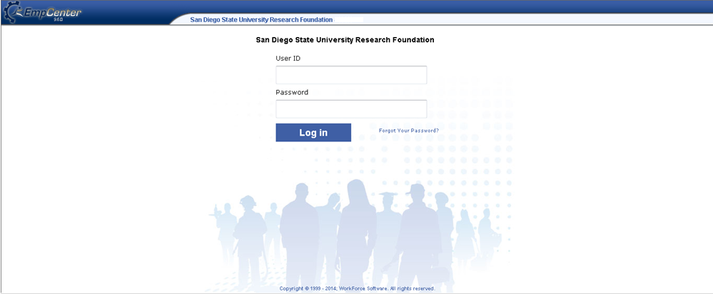
Let’s Get Started Logging In
R + RedID
Temp Password is Your R + Red ID
Users will have access to EmpCenter on May 16th
The first time you log in you will be prompted to create a new password
Notes:
From the Foundation’s website – click on the EmpCenter logon
Enter your User ID which is an uppercase “R” and your Red ID
Your temporary password will be the same as your user ID. (uppercase “R” and your Red ID)
You will be prompted to create a unique password which must be a minimum of 10 digits and contain a combination of upper and lower case characters, numbers and special characters.

Slide 5
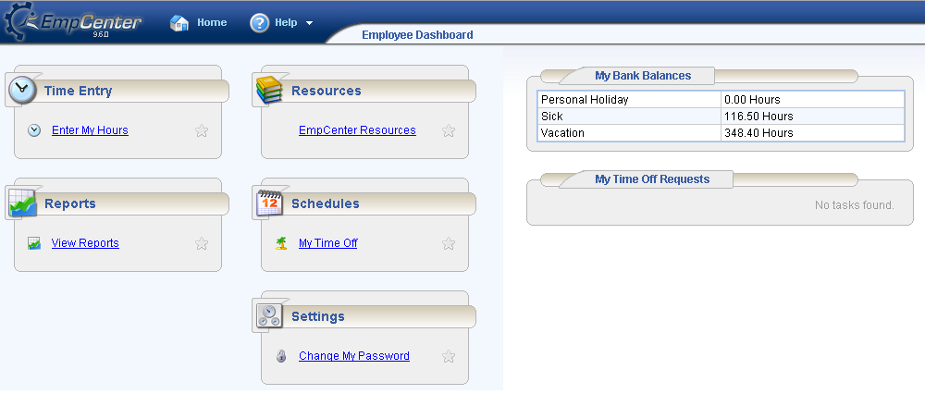
Employee Dashboard
Secondary Blocks
Primary Blocks
Notes:
When you log into EmpCenter, you will be taken to your Employee Dashboard. This is the main screen and starting point.
Your Employee Dashboard consists of 4 primary blocks: Time Entry, Reports, Resources, Schedules and Settings.
In the Time Entry block you can view, enter or update your timesheet data
In the Reports block you can access general reports to view timesheet information for a certain period or periods
The Resources block will link you to the Research Foundation’s EmpCenter Resources page
In the Schedules block you can Submit time off requests, track the status of your requests, and view the history of past requests.
In the Settings block you may choose to change your password.
The Dashboard also includes 2 secondary blocks which enable you to view your leave balances and time off requests
Other information available on your dashboard includes your name, position number and your supervisor’s name

Slide 6
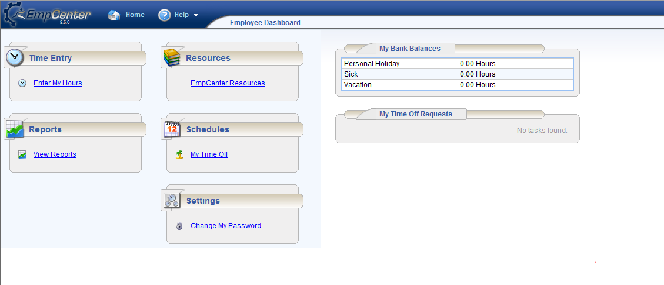
Accessing your Timesheet
Select “Enter My Hours” under “Time Entry” to open your time sheet
Notes:
To open your timesheet, select the Enter My Hours link from the Time Entry block on your dashboard.

Slide 7
“Enter My Hours” for multiple job assignments
Can change to “ABC Project”
Click on the position to bring up your time sheet
If you have more than one paper timesheet you will have multiple EmpCenter timesheets.
SDSURF can label each timesheet so employees can easily identify each job
Naming standards will apply
Notes:
If you have more than one job assignment and currently receive multiple paper timesheets you will have multiple timesheets in EmpCenter.
When you click on “Enter My Hours” you will be prompted to choose the timesheet for the job that you want to log hours.
Timesheet labels can be created for each of your jobs so you can easily tell which timesheet to select to enter your hours.
Once you’ve selected an assignment the appropriate timesheet will be opened and you can enter your time. You will also have the ability to toggle between timesheets in the Time Entry window.

Slide 8
Navigating in your time sheet
Top of the time entry screen shows employee information, job and supervisor
Click on the “home” icon” to return to your dashboard
EmpCenter opens the time sheet for the current pay period
The lower portion of the time sheet tabs to display warning messages, the fund(s) the job is paid from and employee leave balances
Notes:
When you log in, EmpCenter will open the timesheet for the current pay period.
Your employee information, job classification, hours per day and supervisor’s name will be displayed at the top of the time entry window.
You can view past or future pay periods by clicking on the blue arrows or by clicking on the calendar icon and selecting the date.
Click on “Home” to return to your dashboard.
We will review the lower portion of the timesheet in detail later in the presentation.

Slide 9
Navigating in your time sheet
Check the “Show all weeks” box to display all weeks for the pay period
Notes:
The first time you open your timesheet only the first week of the pay period will be displayed.
You can view all weeks in the pay period by checking the “show all weeks” box at the top of the timesheet.

Slide 10
Non-Exempt (hourly) employees
Your job classification is listed at the top of your time sheet. Non-Exempt (hourly) employee classifications include those which start with:
PT
RN
TB, TC, TO, TS
Notes:
You can determine if you are a non-exempt (hourly) employee by looking at your job classification number at the top of the time sheet. (e.g. TC999700)
Classifications that begin with PT, RN, TB, TC, TO and TS are non-exempt (hourly) positions.

Slide 11
Logging Hours - “in” time Non-Exempt (hourly) employees
Click on “Please Select” down arrow under “Earn Code” and select “Work In/Out”
Enter the time you started work. Note: the system defaults to a.m. so if you started at 5:00pm append the number with a p or utilize the 24 hour clock. (e.g. to log in at 2:00pm either enter 2p or 14)
Notes:
As a non-exempt (hourly) employee, you will be entering the actual times you arrive at work, leave and return from your lunch break and leave work for the day on your timesheet.
Click on the “Please Select” down arrow under the “Earn Code” column and select “Work In/Out”. Click on the day you want to log your time.
Enter the time you started work. In this example, the employee started work at 7am. She entered “7” and hit enter – system populated the time in as “7:00 am”.
You should enter your time on a daily basis to ensure your time report has the most accurate accounting of the hours you’ve worked. If you are unable to enter your time daily, enter it on the most frequent basis possible. Do not wait until end of the pay period to log all of your hours or pre-populate all of your time at the beginning of a pay period.

Slide 12
Meal Breaks Non-Exempt (hourly) employees
Lunch break was from 12:00pm to 12:31pm
Enter the time you leave for your lunch break in the “Out” line on the first row of the time sheet
When you return from lunch add another row to the time sheet by clicking the green + sign to the left of the row
Enter the time you return from lunch on the “In” on the second row of the time sheet
Notes:
Under California labor laws, if you work more than five hours you must take a scheduled meal (lunch) break of at least 30 minutes (unpaid). In EmpCenter you will be entering the time you leave and return for lunch on your timesheet.
Enter the “out time” to reflect the time you leave for lunch and “in time” to reflect the time returned from lunch.
In this example the employee took her lunch break at 12:00 noon. She returned from lunch at 12:31pm and entered that into her timesheet.
The employee added a row to her timesheet by clicking on the green “plus” sign to the left of the timesheet row. She selected “Work In/Out” from the Earn Code drop down list and entered the time she returned from lunch on the first line of the new row.

Slide 13
California Law - Meal and Rest Breaks Non-Exempt (hourly) employees
A non-exempt (hourly) employee must be given an opportunity to take a 10 minute paid rest break for every four (4) hours worked or major fraction thereof
Employees must be provided a 30 minute unpaid meal break when they work a period of five (5) or more hours per day
If one or more rest breaks are not given, the employee is owed one hour of pay
The employee is owed one hour of pay if the employee is unable to take a meal period
Notes:
Employees are not required to log the 10 minute rest periods on their timesheets. These rest periods cannot be combined with meal break to take a longer lunch.

Slide 14
Logging Hours - “out time” Non-Exempt (hourly) employees
Finished work at 3:30pm
At the end of the day, enter the time you stopped working.
Hit the save button to save your time entries logged for the day.
Notes:
At the end of your work day, enter the time you stopped work right under the time you returned from your lunch break.
Hit the “Save” button. Once the data is saved the system will generate a “Data Saved” notation and will calculate the total hours worked for the day.
EmpCenter calculates the total hours worked. The total for the day will appear at the bottom of the column of the entries for the day. Weekly totals by paycode will appear under the Total column on far right of the timesheet.
Note: this employee will be paid for 7.98 hours vs. 8 hours on 3/17 because she logged back in from lunch at 12:31pm. Lunch was 31 minutes and is unpaid time.

Slide 15
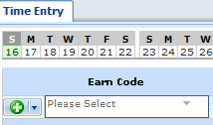
Earn Code Options Non-Exempt (hourly) employees
Additional earn codes are listed on the drop down menu and can be used to record the following:
Vacation Non Exempt Hourly
Unpaid Leave
Sick Leave Non Exempt Hourly
Personal Holiday Non Exempt Hourly
Make up time (worked)
Make up time (out)
Jury/Witness Duty Non-Exempt Hourly
Holiday Worked Non Exempt Hourly
Hourly Hours Banked
Bereavement Leave Non Exempt Hourly
Note: Not all options shown above are available for every employee
Only TB, RN & PT non-exempt/hourly job classifications earn paid time off
Notes:
In addition to the “Work In/Out” Earn Code there are several options listed on the drop down menu (accessed by clicking on down arrow) under the Earn Code column that you can use to record time.
You will only see the options available for your employee classification on the drop down menu.

Slide 16
Reporting paid time off Non-Exempt (hourly) employees – TB, RN, PT
For those hourly/non-exempt employees whose job classifications include paid time off, the time off can be logged by:
Click on the green “plus” symbol to add a row to the time sheet
Select the earn code from the drop down menu
Log the total hours on the appropriate day
Notes:
If your SDSURF appointment is one which includes paid time off (e.g. vacation, sick leave, etc.) you must report the hours taken each day during the pay period.
To record time off, click on the green “plus” sign to create a new row in your timesheet.
Choose the applicable earn code from the drop down menu and enter the number of hours for the day. Enter time off in “elapsed hours” rather than actual “in/out” times.
This employee recorded 8 hours of vacation on 3/18 and 8 hours of personal holiday on 3/20

Slide 17
Reporting paid time off: partial days Non-Exempt (hourly) employees – TB, RN, PT
Enter In/Out times for hours worked
Enter number of vacation hours
Enter the actual time your started work and the actual time you stopped work for the day using the “Work In/Out” earn codes
Add a row to the time sheet and select the earn code
Enter the number of number of hours used for the day and “save”
Notes:
Employees can also log paid time off for partial days.
In this example, the employee worked from 7am to 11am and took 4 hours of vacation for the rest of the workday. The employee entered the time she started work and the time she stopped work for the day.
The employee added a row to her timesheet, selected the “Vacation” earn code and recorded 4 hours to reflect her afternoon off and hit “Save”.
When the employee finishes entering her time and saves, EmpCenter will calculate the total hours for the day for each earn code.

Slide 18
California Labor Law - Overtime Non-Exempt (hourly) employees
Employees will be paid at 1.5 times their regular rate of pay for:
All hours worked in excess of eight hours up to and including 12 hours in any work day
The first 8 hours worked on the seventh consecutive day worked in a single work week
Double the employee’s regular rate of pay for all hours worked in excess of 12 hours in any work day
Weekly Overtime: Employees will be paid at 1.5 times the employee’s rate of pay for all hours worked beyond 40 straight time hours in a work week

Slide 19
Overtime in EmpCenter Non-Exempt (hourly) employees
Indicates exception message
Employees should log actual “In/Out” times for the day and “Save”
EmpCenter will automatically calculate the hours worked for the day
A Yellow “Pin” will appear on the timesheet to designate overtime hours worked
Notes:
EmpCenter calculates the total number of hours worked each day based on the “Work In/Out” times logged by the employee.
If an employee is required to work overtime hours, he/she only needs to record their actual in/out times. EmpCenter will automatically calculate the overtime hours for any hours worked in excess of 8 per day.
An exception message appears on the timesheet on the day the overtime hours were worked to note total hours for the day exceeded 8.
Employees should obtain the approval of their supervisor prior to working any over time hours.

Slide 20
Overtime in EmpCenter Non-Exempt (hourly) employees
Check the “Exceptions” tab at the bottom portion of the time sheet for information
Your supervisor will review these exception messages when approving your time sheet
Notes:
The “Pin icon” on the timesheet indicates that a conflict exists between what the employee entered on the timesheet and the system rules under which the timesheet in processed. In this example, the pin was generated because the employee worked more than 8 hours in one day.
The Exceptions tab on the lower portion on the timecard provides detailed information on the exception including the date and a message describing the problem.
In this example, the employee worked overtime on 4/14 . The Message : “Daily hours (10) exceed the standard daily hours (2)” indicates 2 hours of overtime was worked.

Slide 21
Exempt Employees
Your job classification is listed at the top of your time sheet. Exempt employee classifications include those which start with:
OO
SE
RE, RM, RA
Notes:
You can determine if you are an exempt employee by looking at your job classification number at the top of the time sheet. (e.g. RE995400)
Classifications that begin with OO, SE, RE, RM and RA are exempt positions.

Slide 22
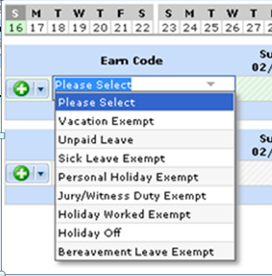
Completing your time sheet Exempt employees
Exception Time Options
Exempt employees log exception time only.
Click on “Please Select” down arrow under “Earn Code.”
This will provide the list of exceptions that can be logged.
Notes:
Exempt employees are only required to log exceptions such as vacation or sick leave on their time sheet.
To log an exception, click on the arrow in the Earn Code column to select the type of time needed from the list of options available on the menu.

Slide 23
Completing your time sheet Exempt employees
Enter sick leave hours for 2/20
After selecting your earn code you will be able to log the hours for the exceptions.
To report hours for a different earn code, click the green “plus” sign at the front of a row to add another row to your time sheet.
Select the appropriate earn code and add the hours to your time sheet.
Notes:
Enter the number of hours on the appropriate day.
Exempt employees must enter exceptions in full or half day increments based on your FTE. (e.g. A 100% FTE employee would enter exception time as either 4 or 8 hours).

Slide 24
Completing your time sheet Exempt employees
Hit the “Save” button to save the time logged in your time sheet.
A “Data Saved” notation will appear to show that the information has been retained.
Notes:
When you have completed your time sheet, hit the “Save” button.
EmpCenter will display a “Data Saved” message to confirm your entries.

Slide 25
Exception Messages All employees
The “Exceptions” area at the bottom of the time sheet will note issues with your time sheet.
Exception messages are color-coded to identify the level of severity:
White: No exceptions or only informational messages present
Yellow: Warnings present
Red: Errors present
Errors (Red) must be corrected prior to saving and submitting your time sheet.

Slide 26
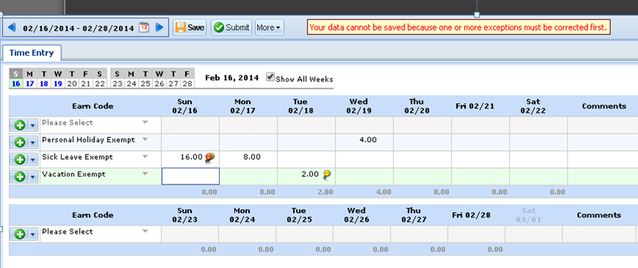
Exception Messages All employees
A “pin” icon indicates there may be a problem with the information entered on the timesheet
Red level exceptions need to be corrected before the time sheet is submitted
Notes:
You will need to correct any red exceptions before the system will allow you to submit your timesheet to your supervisor.
In this example, the employee entered 16 hours of sick leave on 2/16 which generated a red level exception message. The employee will need to correct the number of hours entered in order to be able to submit his timesheet.
The employee also entered 2 hours of vacation on 2/18 which generated a yellow (warning) level exception.

Slide 27
Exception Messages All employees
Check the “Exceptions” tab at the bottom portion of the time sheet for information
Your supervisor will review these exception messages when approving your time sheet
Notes:
Employees should check the Exceptions tab for detailed information and correct any red level exceptions.

Slide 28
Submitting your time sheet All employees
At the end of the pay period, click the Submit button to send your time sheet to your supervisor
You must submit a time sheet every pay period even if you have no hours or time off to report.
Notes:
All employees must submit their time sheet to their supervisor by the payroll deadline to be paid.
You can submit your time sheet early if your last day of work for the pay period is before the end of the pay period. For example, if you are going on vacation for a week you can log your vacation hours and submit your timesheet to your supervisor.

Slide 29
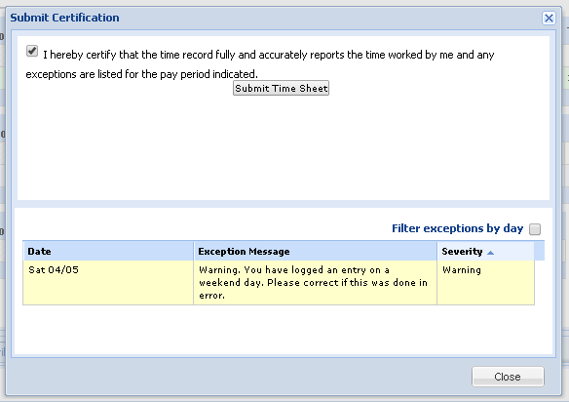
Submitting your time sheet All Employees
You will be prompted to certify that the time you’ve reported is accurate.
Notes:
When you hit the “Submit” button you will be prompted to certify the time that you’ve reported is accurate.
The certification language is customized for Non-exempt and Exempt employee classifications. Your timesheet will have the language that is appropriate for your classification.
Once you’ve read the certification statement, click on the box in the upper left hand corner.
Click on the “Submit Time Sheet” button to send the time sheet to your supervisor for approval.

Slide 30
Submitting/Recalling your time sheet
Use Recall to correct errors
A message will appear to confirm that the time sheet has been submitted to your supervisor.
Once submitted if a change needs to be made your time sheet can be recalled by clicking on the “Recall” button
The Recall option is only available if your supervisor has not approved your time sheet.
Message indicates that the time sheet has been recalled.
Make changes to the time sheet you have recalled and hit save
Submit your time sheet again by clicking on the submit button
Notes:
If you need to correct an error or omission after you have submitted your timesheet, you can use the “Recall” button to retrieve your timesheet.
The “Recall” option is only available if your supervisor has not approved your time sheet.
When your time sheet is recalled, make your adjustments, certify and submit to your supervisor.

Slide 31
Rejection?
If your supervisor cannot approve your time sheet, she/he will “reject” the time sheet and you will receive an email alert.
The email subject indicates which time sheet has been rejected and the body of the email should indicate why it’s been rejected.
You will need to correct the error/omission and re-submit the time sheet to get paid.
Notes:
If your supervisor notes an error or omission on your timesheet he/she will reject your time sheet so that you can make the necessary corrections.
The employee will receive an email message stating the reason(s) the time sheet has been returned.
The employee will log in to EmpCenter, make the necessary corrections and re-submit the timesheet.

Slide 32
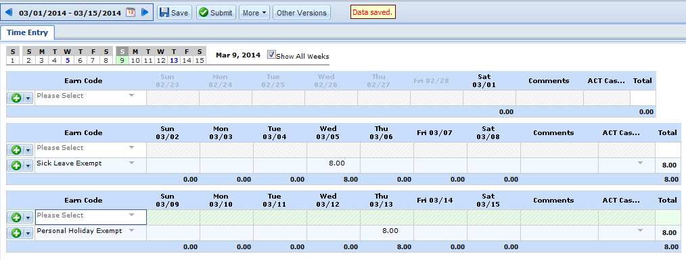
Rejection?
Rejected time sheet shown as not processed
The rejected time sheet will display again as “unsubmitted”
Make corrections needed and re-submit to your supervisor
Notes:
When you log in to EmpCenter to make corrections on a rejected time sheet, the time sheet will show as not submitted.
Make the corrections needed, hit “Submit” to send the corrected time sheet to your supervisor.

Slide 33
Approval!
Once your time sheet has been submitted and approved by your supervisor it is submitted to payroll to be processed.
The time sheet for that pay period will reflect this at the top of the “Enter My Hours” screen for that pay period.
Notes:
Once your time sheet has been submitted and approved by your supervisor it is submitted to payroll to be processed.
The time sheet for that pay period will reflect this at the top of the “Enter My Hours” screen for that pay period.

Slide 34
Time Off Requests
EmpCenter can also be used to request and manage time off requests (TORs.)
You can submit time-off requests, track the status of your requests, and view the history of past requests through the “My Time Off” box.
An email will be sent to your supervisor notifying her/him that a request for time-off was made.
When requests are approved the hours are populated on the time sheet.
Job classifications that earn paid time off will start with RE, RM, PT, RN and TB.

Slide 35
Requesting Time Off
From the dashboard, under the Schedules block click on “My Time Off.”
Notes:
To send a request for time off to your supervisor select the My Time Off options under the Schedules block on your dashboard.

Slide 36
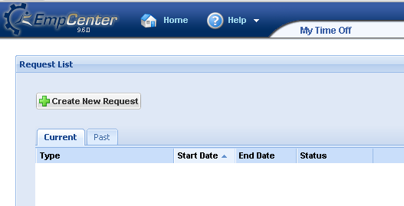
Requesting Time Off
Click on “Create New Request”
Notes:
The Request List will show any current requests that you have submitted to your supervisor that have not yet been reviewed.
You can also view the history of past requests by clicking the “past” tab
To submit a new request, click on “Create New Request”

Slide 37
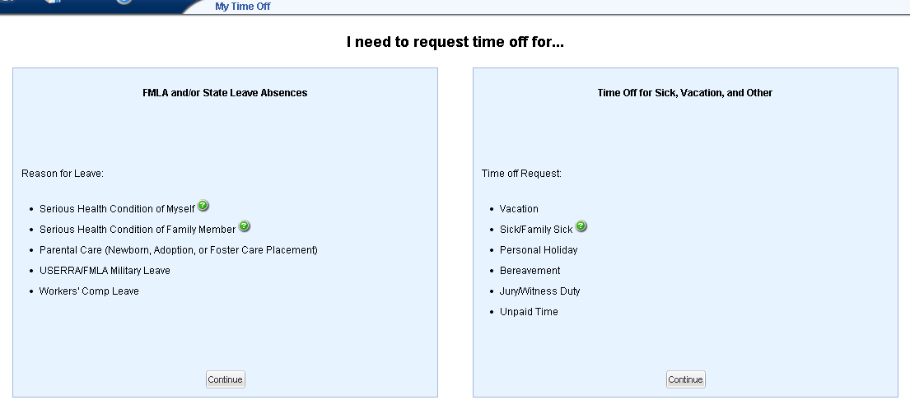
Requesting Time Off
Requests are submitted to your Supervisor
Requests are submitted to HR
Notes:
EmpCenter will prompt you to choose the type of time off request you need.
“FMLA and/or State Leave Absences” should be used to request a leave of absence. EmpCenter will prompt the employee to answer a series of questions based on the type of leave requested and how you would like to receive information regarding your request (i.e., phone, email, etc.). The completed request is submitted directly to the Human Resources department.
If you select “Time Off for sick, Vacation, and Other” your request will be submitted directly to your supervisor for review.

Slide 38
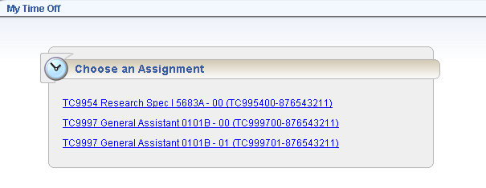
Requesting Time Off
If you have more than one Assignment the “Choose an Assignment” window will appear. Select the job that applies to this request.
Notes:
If you have multiple time sheets, EmpCenter will prompt you to select the job that you are requesting time off from.
If you need time off from multiple jobs, you will need to create a request for each job.

Slide 39
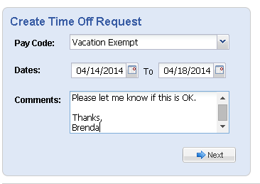
Requesting Time Off
Step 1 – Using the “Create Time Off Request” block - Select the dates for your request.
Once the information is complete click “Next” to create your request.
“Type” of time off
Notes:
In the “Create Time Off Request” box, you will need to pick the type of time off you need (under Pay Code)
You will also need to input the dates associated with your request.
Type a message to your supervisor in the Comments box regarding the request. This message will be sent to your supervisor in an email.

Slide 40
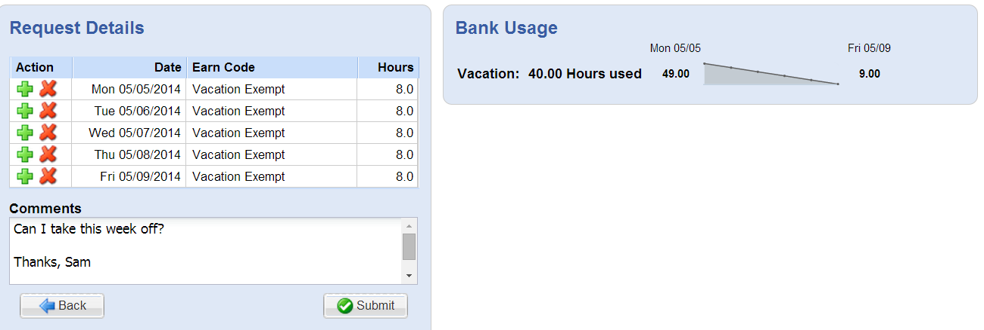
Requesting Time Off
Step 2 – Review the time off request. If correct click on the “Submit” button to forward the request to your supervisor.
Notes:
1. The Request Details box will indicate if there are any issues (exceptions) associated with your request. You will also see a summary of your available leave balances and Bank Usage .
2. Adjustments to the request can be made under the “Action” column under Request Details.
3. Review your request and make any changes needed. If no exceptions prevent you from submitting the request, click the “Submit” button to submit your request to your supervisor for review

Slide 41
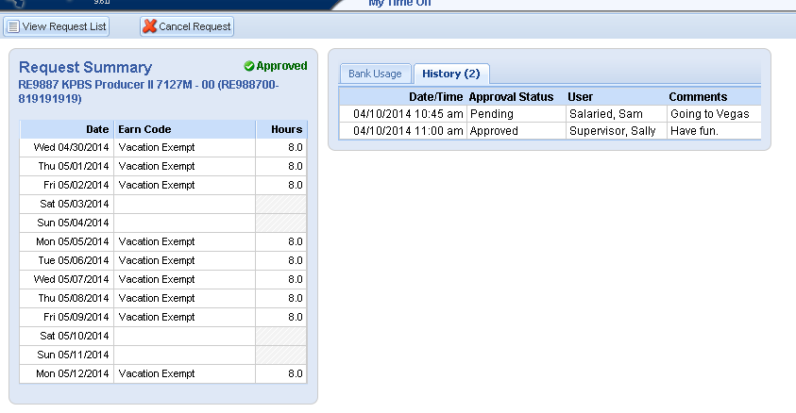
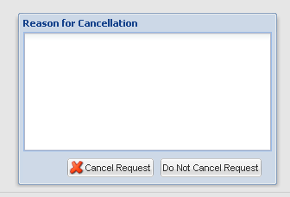
Cancelling a Time Off Request
Enter the reason for cancelling your request
.
A request can be cancelled before or after it’s approved
Select the request and click “Cancel Request”
Notes:
You can cancel a time off request before or after it has been approved.
Go to “Schedules” under My Time Off Box and select the request from the “Current” Tab.
The View/Cancel Time Off Request window appears listing the details and history of the request.
Click “Cancel Request” at the top of the window to withdraw your request.
The “Reason for Cancellation” window appears. Type a message to your supervisor letting him/her know why the request is being cancelled. This message will be sent to your supervisor in an email message.

Slide 42
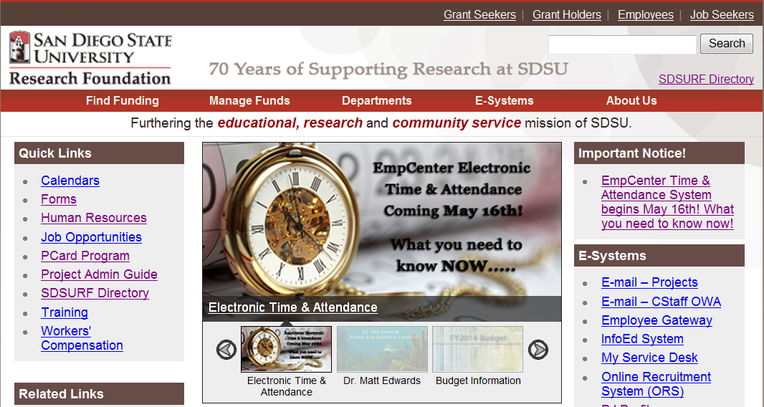
EmpCenter Resources
Information on EmpCenter is currently available on the Research Foundation’s website: www.foundation.sdsu.edu
Notes:
Information about the EmpCenter, access to forms, training materials (including short videos and cheat sheets) are available on the EmpCenter page on the Research Foundation’s website.

Slide 43
EmpCenter Time & Attendance
Supervisor Training

Slide 44
After this training, you will be able to:
Log in to EmpCenter and navigate through the system as a manager/supervisor.
Review, approve, edit, and submit employee timesheet information for your staff.
Review Leave Balances for your staff.
Process Time Off Requests (TORs.)
Delegate approval authority to other supervisors.

Slide 45
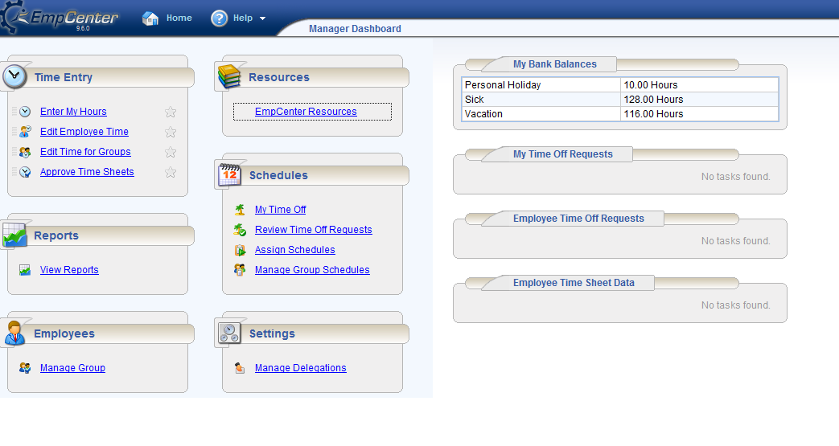
Manager Dashboard
Secondary Blocks
Primary Blocks
Notes:
When you log into EmpCenter, you will be taken to your Manager Dashboard. The manager dashboard offers functions not available to employees that are designed to assist supervisors in managing employee time. Managers can use these options to edit and approve employee timesheets, and review and approve employee time off requests.
Your Manager Dashboard consists of 6 primary blocks: Time Entry, Reports, Employees, Resources, Schedules and Settings.
In the Time Entry block you can view, enter or update your timesheet data and your employee’s timesheet data
The Reports block allows you to view and generate reports, view timesheet information for a certain period and view delegated roles or comments on timesheets.
The Resources block will link you to the RF’s EmpCenter Resources page
In the Schedules block you can manage and track your individual time off requests and review time off requests submitted by your employees. You also have the ability to assign and manage schedules for hourly employees.
Settings block gives you the capability to change your password and delegate supervisory responsibility to another manager.
The Dashboard also includes 2 secondary blocks which enable you to view your leave balances and time off requests
Other information available on your dashboard includes your name, position number and your supervisor’s name

Slide 46
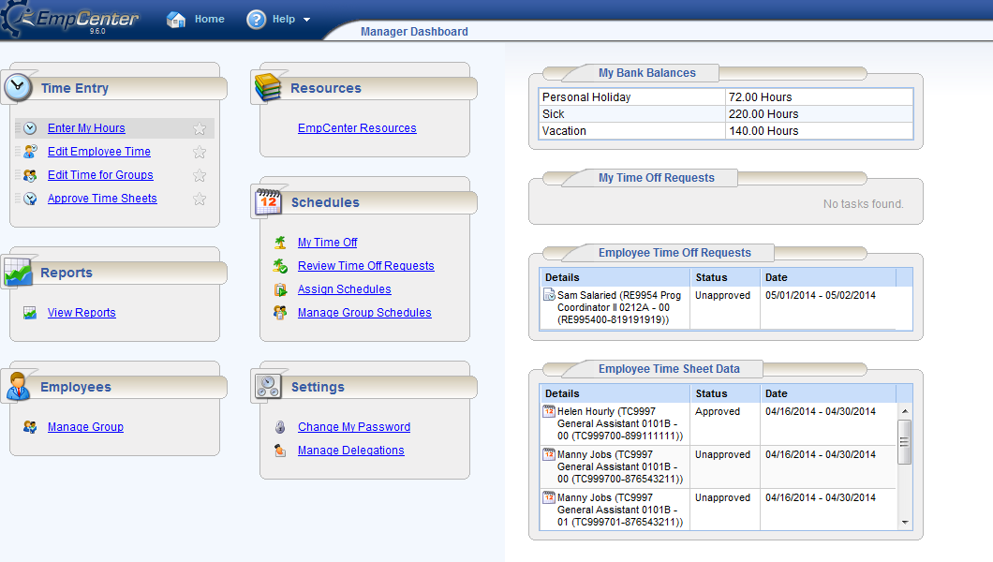
Approving Employee Time Sheets
Select Approve Time Sheets
Status of Employee Timesheets
Notes:
Managers can approve timesheets for individual employees or for an entire group. To access employee timesheets select “Approve Timesheets” option from the Time Entry Window.
Mangers can see the status of employee timesheet in the secondary blocks on the bottom right. The status column indicates which employee timesheets have been approved.

Slide 47
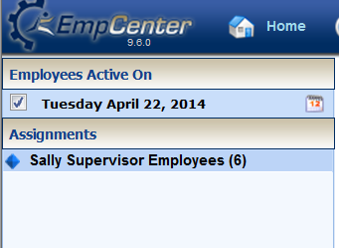
Approving Employee Time Sheets
All employees or groups that are assigned to you will appear in the window.
Select the group of employees whose timesheets you want to review from the groups listed under Assignments
The employee timesheets will populate on the right side of the screen
Notes:
Your groups of active employees as of the current pay period will be listed on the left side of the screen.
Under Assignments, select the group of employees whose timesheets you wish to review. In this example, Sally Supervisor has one group of 6 employees assigned to her.

Slide 48
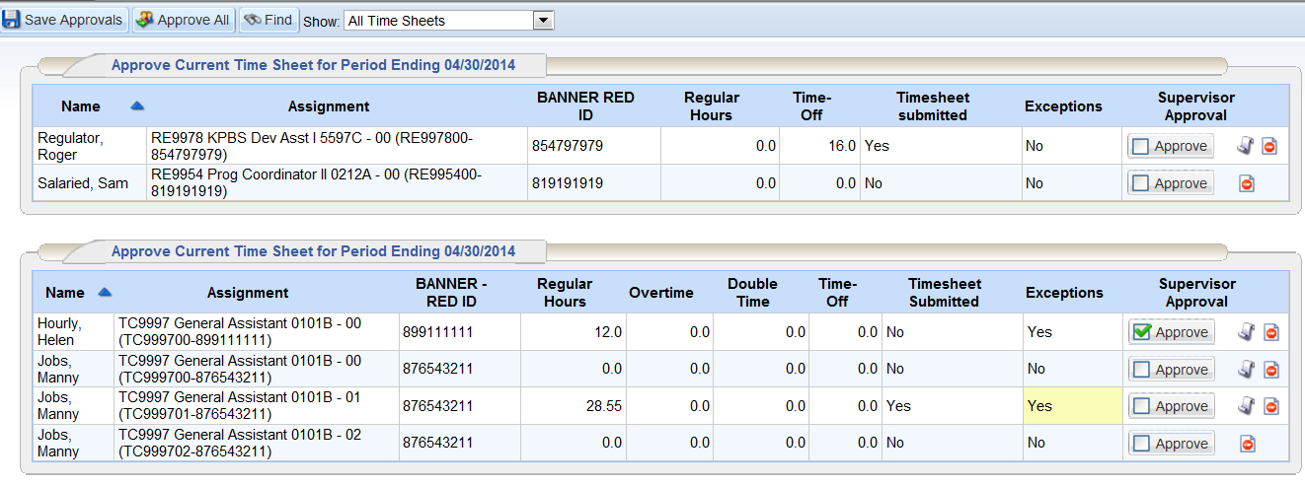
Approving Employee Time Sheets
Employee timesheets are grouped by type of position
Timesheet submitted column indicates what timesheets are ready for review
Notes:
This screen summarizes the details of the timesheets that you need to review and approve so that your employees will receive a paycheck. Supervisors are responsible for reviewing and approving employee timesheets by payroll deadlines.
Timesheets are grouped by Exempt and Non-Exempt positions. In this example, the exempt employee timesheets are in the first block and the non-exempt employees are in the second block.
The timesheet submitted column indicates which employees have submitted their timesheets for your review and approval. The “Exceptions” column indicates if there is an issue on the timesheet that needs review or action prior to approval.
Click anywhere on the row of the employee whose timesheet you want to review.

Slide 49
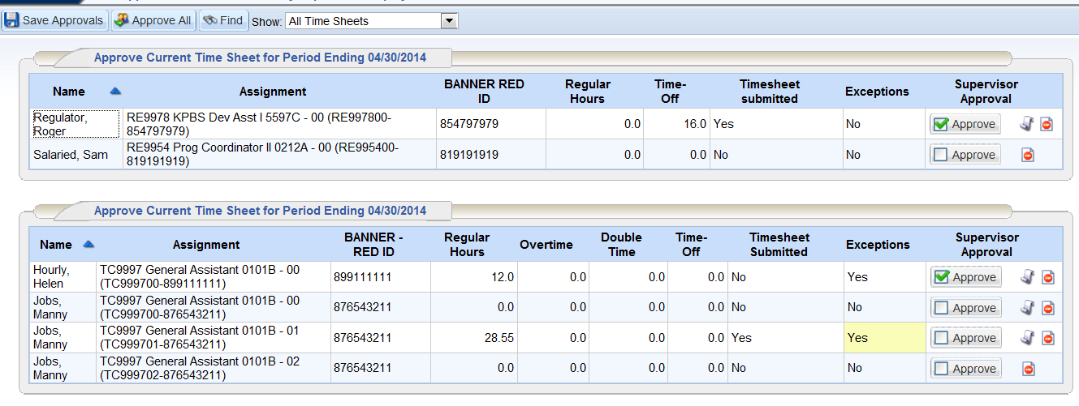
Approving Employee Time Sheets
“Save Approvals” to finalize
Check Approve box
If timesheet is accurate, click on the “Approve Box”
Select “Save Approvals” to finalize and submit timesheet
Notes:
If the time reported by the employee is accurate, click on the “Approve” box in the Supervisor Approval column to approve the individual employee timesheet.
Select “Save Approvals” to finalize the timesheet. When the employee opens his/her timesheet, a note appears informing him/her that the hours have been approved.
Supervisors can also review timesheets for all employees and use “Approve All” to approve timesheets for the group of employees. This will not work if there are any errors or exceptions that need to be corrected.

Slide 50
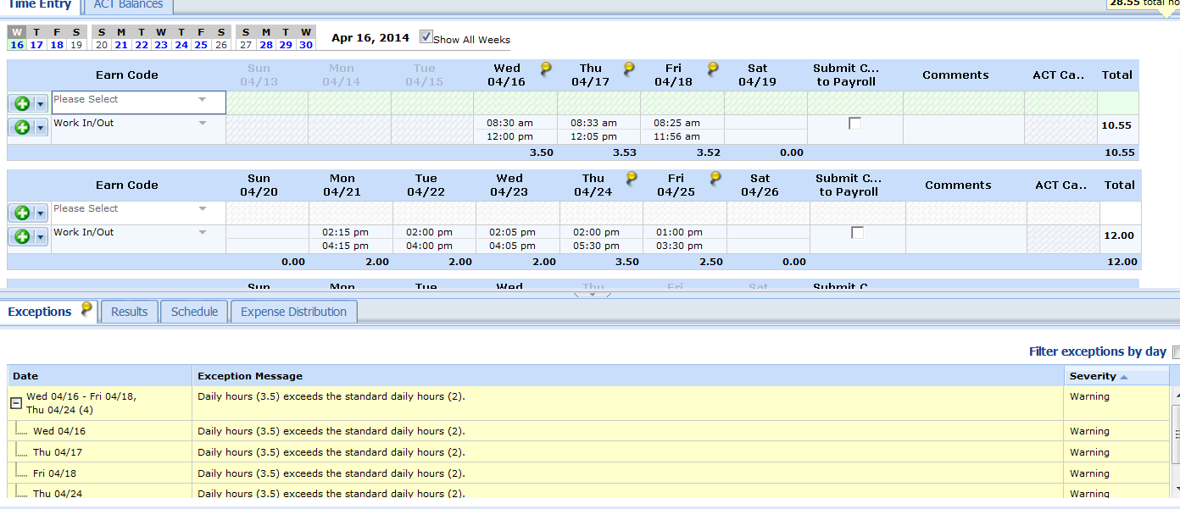
Approving Employee Time Sheets
Pin “icon” indicates an exception on a work day
Exceptions Tab provides details on the issue that has occurred
In this example, the employee worked more than 2 hours per day, which generated an exception message
Notes:
If there is an “exception” a Pin icon will appear on the timesheet on the day the exception occurred.
The Exceptions tab at the bottom of the timesheet will provide detailed information for your review.
In this example, the employee was set up to work 2 hours/day and exceeded the 2 hours on a number of days. If an hourly employee has an appointment to work 10 hours per week, EmpCenter will divide the 10 hours over the five work days in the week. Any deviation will prompt an exception message.
This exception message does not require any action other than review on the part of the manager.

Slide 51
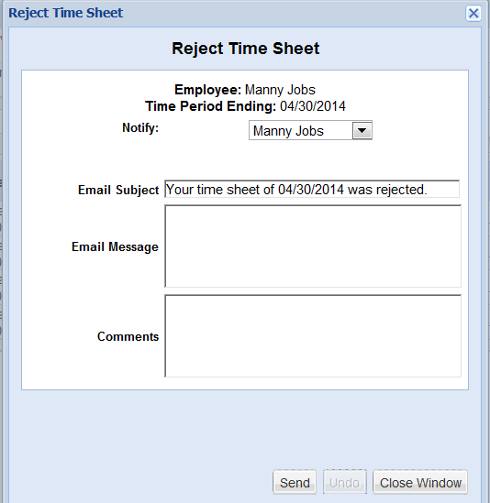
Rejecting a Time Sheet
Reject Time Sheet
If the timesheet has errors, the supervisor can “Reject” and send back to the employee for corrections
Employee will get an email message
You entered sick leave on 4/18 and you were out on 4/17. Please correct.
Notes:
If there is an error on the timesheet, supervisors should reject the timesheet to re-route back to the employee. The employee can make the requested corrections and re-submit his/her timesheet for approval.
To reject a timesheet, click on the red button in the Supervisor Approval column.
The Reject Timesheet window will prompt you to enter a message to the employee regarding the reason the timesheet is being rejected and action that needs to be taken to correct any errors. Hit send to reject the timesheet.
The employee will receive a notification via email that will include the message you input.
If an employee is not able to make the corrections on his/her timesheet or there are other extenuating circumstances, the supervisor can make the corrections under the “Edit Employee Time” on the dashboard. The employee will be notified by email that another individual made changes to their time sheet.

Slide 52
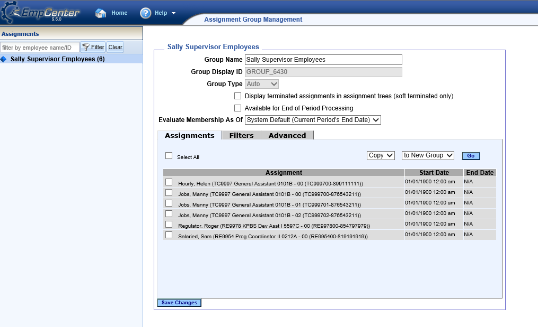
Managing Employee Groups
Select Manage Groups from the dashboard
Click on the group name to bring up list of all employees
Notes:
From the Dashboard, select Manage Group in the Employees block to bring up your employee assignments.
Click on the group of employees under the Assignments column to bring up a list of all employees in the group.

Slide 53
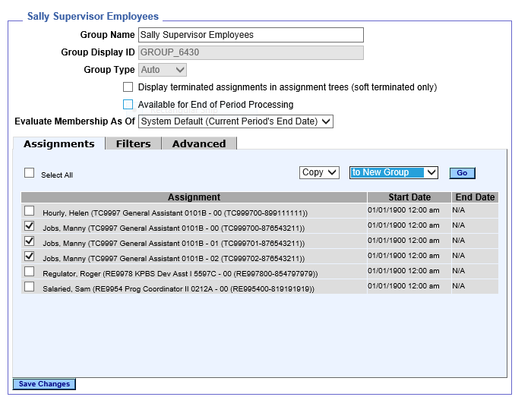
Managing Employee Groups
Select Employees for new group
Select Copy, to New Group
“Go”
Select the Employees for a new group
Notes:
If you have a large number of employees reporting to you may want to group them together so that you can easily manage different teams or delegate supervision for a team to another supervisor. You can create different groups of employee assignments.
To create a new group select the employees by clicking the box next to the employee job. In this example, we are creating a new group for all of Manny Job’s assignments.
From the drop down menus select COPY to New Group
Hit Go

Slide 54
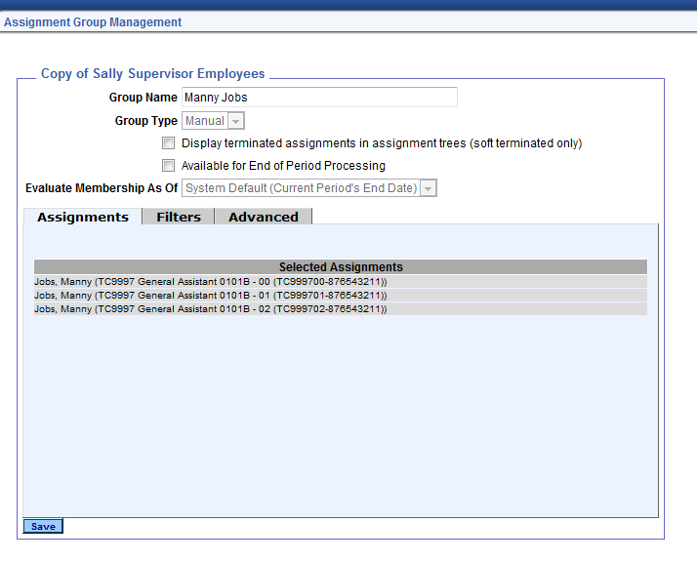
Managing Employee Groups
Change Group Name
Notes:
Your new group has been created.
The new group name will show as “Copy Of….”
Under Group Name type a name the group you’ve created.
Save change

Slide 55
Delegation of Authority
Delegation is the act of granting someone else authority over your group of employees, typically when you are not available.
Managers must delegate to an individual who is trained to review and certify time sheets for employees.
Delegation can be given to for a specific group of employees on an on-going basis
Delegation can be given for a set period of time (e.g. while supervisor is out of the office)

Slide 56
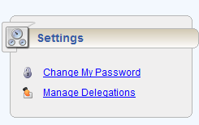
Delegation of Authority
To delegate, from your dashboard select Settings > Manage Delegation.
Select Delegate Authority.
Notes:
To delegate a group of employees to another supervisor, select Manage Delegation under the Settings block on your dashboard.
Select “Delegate Authority”

Slide 57
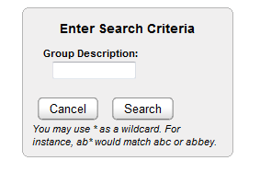
Delegation of Authority
To display all Groups
click “Search”
Choose the group of employees to delegate to another user
Do not check this box
Notes:
The Enter Search Criteria Window appears. This window allows you to search for one or more assigned groups.
Click “Search” in the “Enter Search Criteria” box to bring up a list of your groups.
A window listing your assigned groups and your role for each group will appear.
In the Assignment Group column, select the check box next to the group name you wish to delegate.
The delegated role will remain “Manager/Supervisor, Group.”
In the effective date and end effective date columns, enter the dates of the delegation. Enter 12/31/3000 if you want to delegate on an on-going basis.
Do not check the box allowing for re-delegation of authority to another user. If this box is checked the system will allow the person you delegate to re-delegate without your knowledge. Best Practice is to never check the “Allow to Re-delegate” checkbox.
Hit “Next”

Slide 58
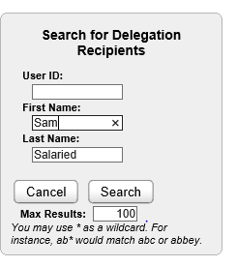
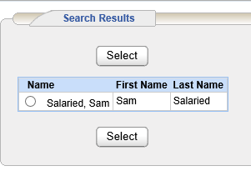
Delegation of Authority
Search for the person you want to delegate to
Search by User ID, Name or wildcard
Select Delegate from list
Notes:
Enter the name or user ID (R + RedID) of the person you want to delegate to. You can also use the * wildcard to search.
Select your delegate from the search results and hit “Select”.
A message will pop up stating the delegation was successfully completed.

Slide 59
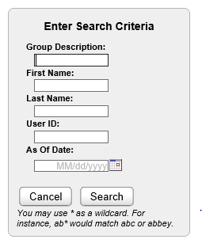
Revoking Delegation
Select View/Revoke Delegations from the dashboard
Search to bring up list of your delegates
Notes:
To revoke delegation, Select View/Revoke Delegations from the Manage Delegations block on your dashboard.
In the “Enter Search Criteria” box click “Search” to bring up list of your delegates.

Slide 60
Revoking Delegation
Select “Revoke”
Select “Revoke All” (if shown) to cancel all delegations
Notes:
Click on the row to revoke the delegation.
If you have multiple delegations selecting “Revoke All” cancels all delegations.

Slide 61
Revoking Delegation
Enter effective date or check “Revoke Immediate”
Hit “Confirm”
Notes:
To revoke delegation, enter the effective date you want the delegation to end or check the “Revoke Immediate” box.
Hit “Confirm”

Slide 62
Managing Time Off Requests
EmpCenter can also be used to request and manage time off requests (TORs).
If you choose to use this functionality, employees can submit time off requests, track the status of requests and view the history of past requests.
Managers can approve or reject TORs, review employee leave balances and TOR history.
EmpCenter generates email messages to alert Managers to new requests.
EmpCenter generates email message to notify employees that a request was approved or rejected.

Slide 63
Managing Time Off Requests
Pending Requests
Pending requests will appear in the Employee Time Off Requests block on your dashboard.
Access pending requests by selecting “Review Time Off Requests”
Notes:
Pending requests for time off will appear in the Schedules Block under Employee Time Off Requests on your dashboard.
Access pending requests by selecting “Review Time Off Requests”

Slide 64
Managing Time Off Requests
Select the request you want to review by clicking on it.
Notes:
Under the Pending Requests tab, click the request you would like to review.
You can also review the history of past requests by selecting the “Time Off Request History” tab.

Slide 65
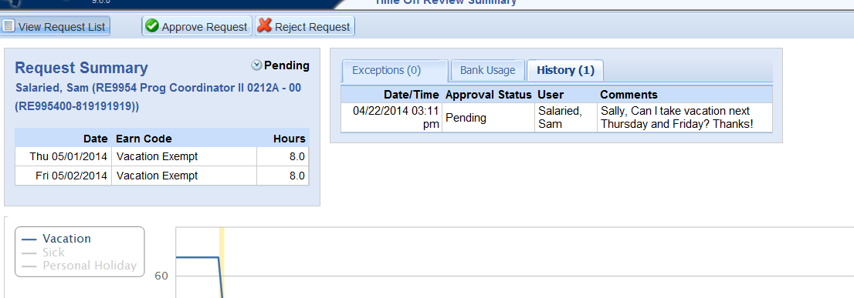
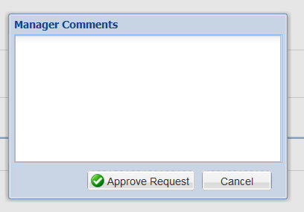
Managing Time Off Requests
Hope you enjoy your long weekend!
Click “Approve” or “Reject” and enter a message to the employee in the Manager Comments box
Click “Approve” or “Reject” to send email to employee
Notes:
Review the request summary and any exceptions associated with the request. You can review the employee’s leave balances as of the current pay period by selecting the “Bank Usage” tab.
You can either approve or reject the request by clicking on the appropriate button.
Enter a message to the employee in the Manager Comments box. The employee will receive an email message stating that the request was either approved or rejected and your comments will be included in the message.
Managers can also cancel a previously approved request by opening the request and following the EmpCenter prompts for information to cancel the request and notify the employee via email regarding the reason for cancellation.

Slide 66
Final Notes for Supervisors
Complete an Approving Supervisor/Manager Agreement form and submit to SDSURF Payroll
Check PI Profile to ensure your active employees have a supervisor assigned to them.
Encourage your staff to attend training!
If you have any questions please submit to: timefeedback@foundation.sdsu.edu

