Slide 1
PROCUREMENT CARD PROGRAM

Slide 2
Contents
Introduction 3
Cardholder Registration 5
Approving Manager & Admin. Assistant Log In 8
Approving Manager Email Notification 11
Transaction Allocation 14
Splitting a Transaction 22
Cardholder Transaction Approval/Forward 26
Pulling Back a Transaction 29
Approving Manager Transaction Approval 33
Approving Manager Transaction Rejection Process 39
Cardholder Manage a Rejected Transaction 42
Dispute a Transaction 45
Cancel a Dispute 51
Account Activity Report 56
Submission of Paperwork 59
2014 PCard Deadlines 60
Cardholder & Approving Manager Responsibilities 63
Billing & Shipping Address 65
Resources Available to You 66

Slide 3
Introduction
Transaction Approval Process (TAP) allows three types of user functions:
1) Cardholders will use TAP to allocate, approve, and forward transactions to their Approving Manager.
2) Administrative assistants can allocate, approve, and forward transactions to the assigned Approving Manager on behalf of the Cardholder. Administrative assistants cannot final approve transactions.
3) Approving Managers will use TAP to review, reject or final approve transactions forwarded to them.
All three roles can perform the following basic procedures:
1) Approve Transactions
2) Pulling Back Transactions- transactions that have not been modified can be pulled back.
Approving Managers can also reject transactions.
Approving Managers can reject transactions and send them back to the cardholder. The rejecting Approving Manager must specify a rejection reason so that the cardholder receiving the rejected transaction knows how to manage it.

Slide 4
Cardholder Registration If you are a cardholder and are your own approving manager, do not follow this step. Follow the steps for the Approving Manger.

Slide 5
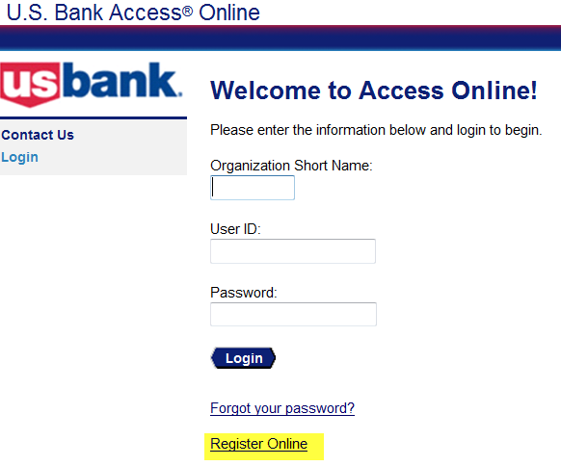
Cardholder Registration
Go to https://access.usbank.com
Click Register Online
Organization Short Name = SDSURF
Enter in your account number and expiration date as noted on your card.
Select Register This Account

Slide 6
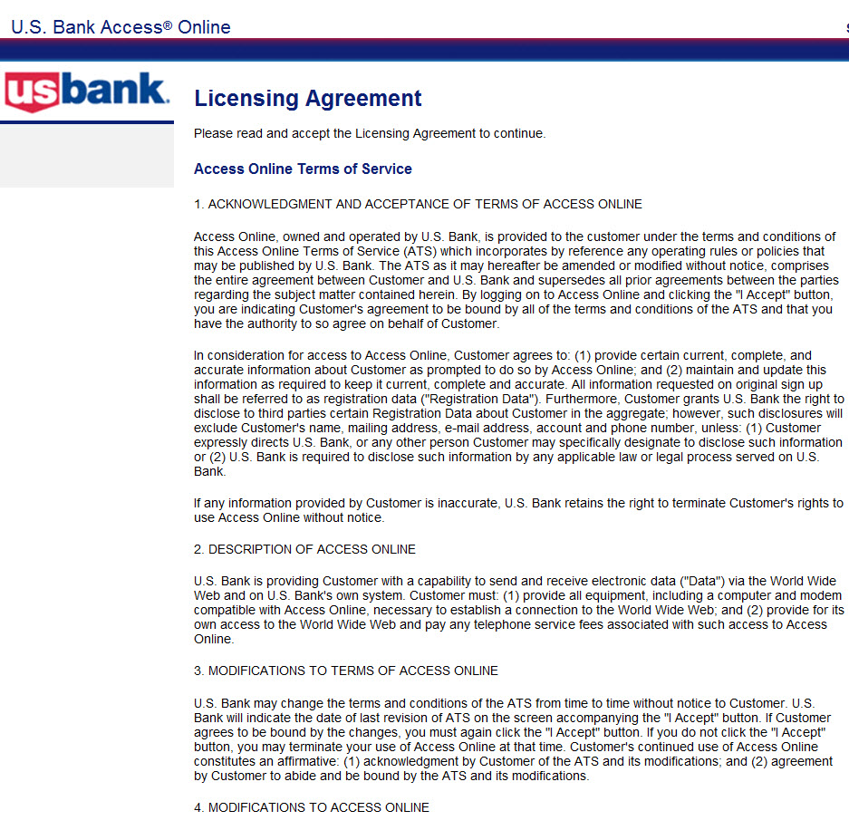
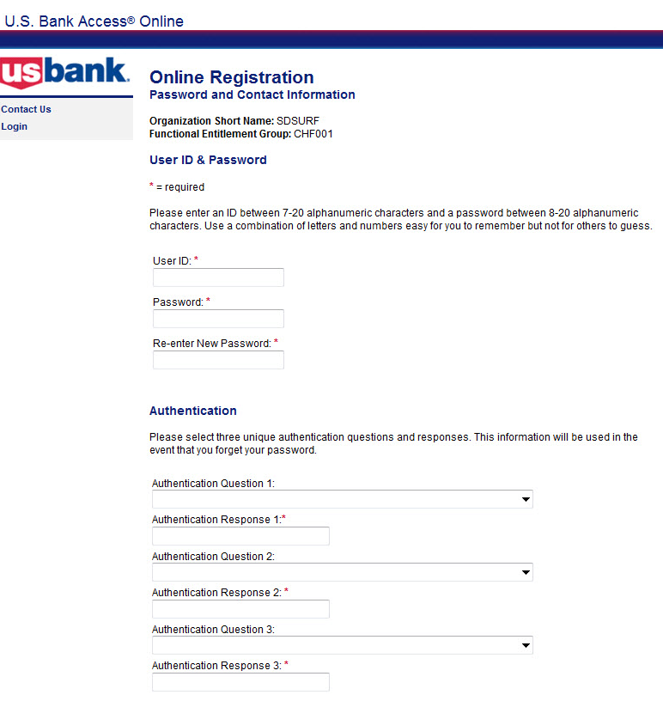
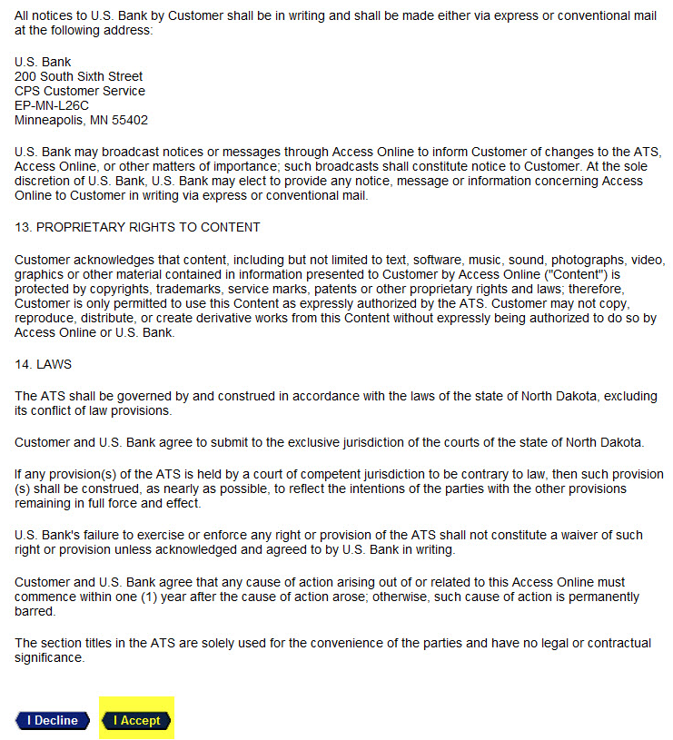
Cardholder Registration
After reviewing the Licensing Agreement, click Accept at the bottom.
Complete requested information.
User ID should be your first initial and last name (no space between). If your User ID is less than seven characters, add port at the end of your last name. EX: jsmithport
Password must be 8-20 characters with at least one numeric character, one capital alpha character and one special character.
Note: Verification questions/answers are used to authenticate your account when calling the bank.

Slide 7
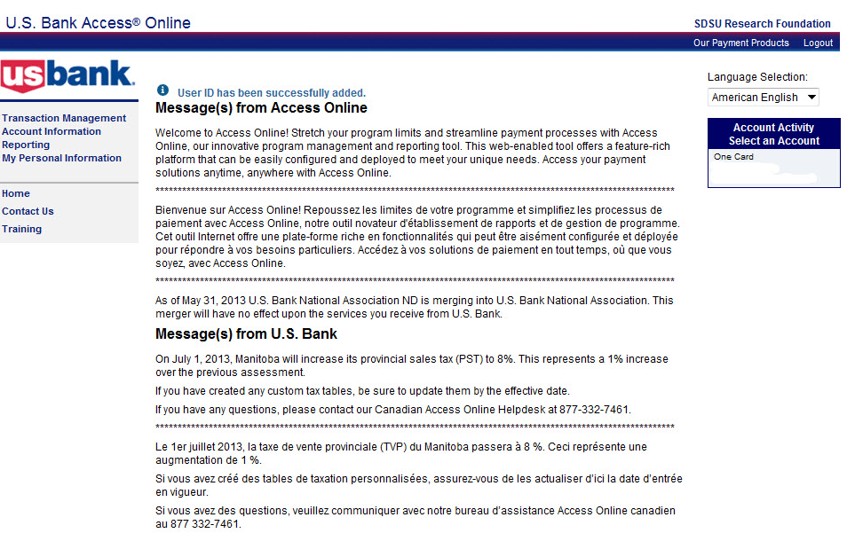
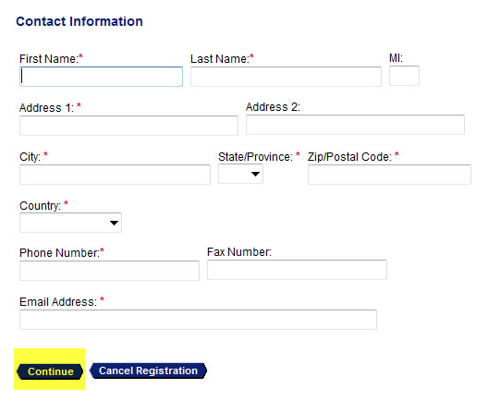
Cardholder Registration
Contact Information
Enter in your campus address, phone number and email address.
Click the Continue button.
Registration is Complete
Account information will be displayed here.
Note: You will still need to call the number printed on your card to activate it. Remember to enter in the last four digits of your Red ID and not your SSN.

Slide 8
Approving Manager & Administrative Assistant Log In

Slide 9
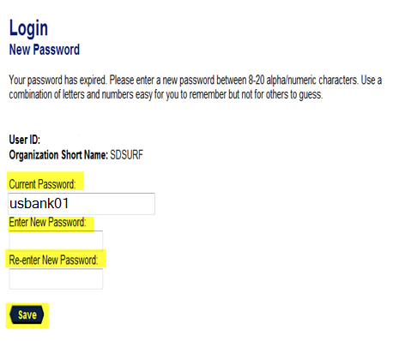
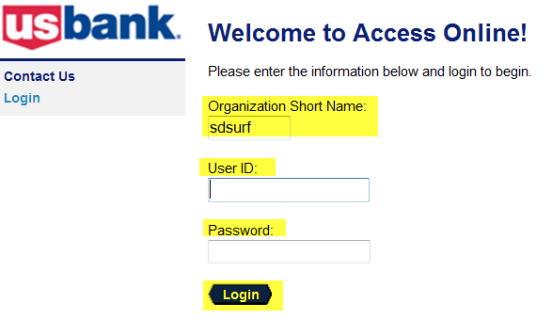
Approving Manager & Administrative Assistant Log In
Go to https://access.usbank.com
Enter in the following information
1. Organization Short Name = sdsurf
2. User ID = first initial and last name (no space between). If your user name is less than seven characters, add “port” after your last name.
EX: jsmithport
3. Enter in your temporary password (usbank01)
You will be prompted to change your password once you log in.
4. Click Login
Create a new password and Click Save.
Aztec2015*
Aztec2015*

Slide 10
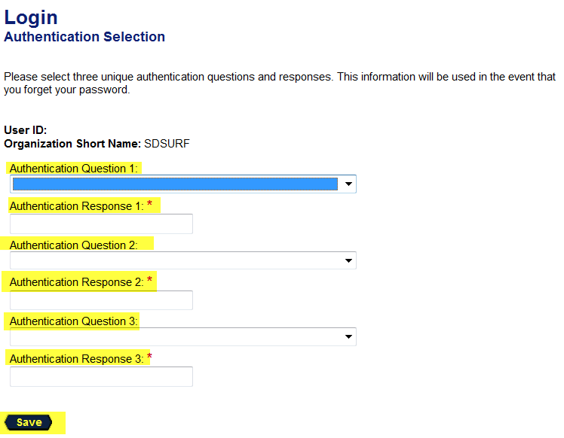
Approving Manager & Administrative Assistant Log In
The verification questions/answers are used to authenticate your account when calling the bank if you forget your User ID or Password.
Review the Licensing Agreement and Click Accept

Slide 11
Approving Manager Email Notification

Slide 12
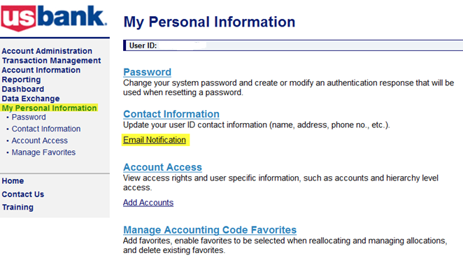
Approving Manager Email Notification
Log in to access.usbank.com and follow the steps below to establish your email
preference to receive email notifications.
Select My Personal Information
Under Contact Information, Click Email Notification

Slide 13
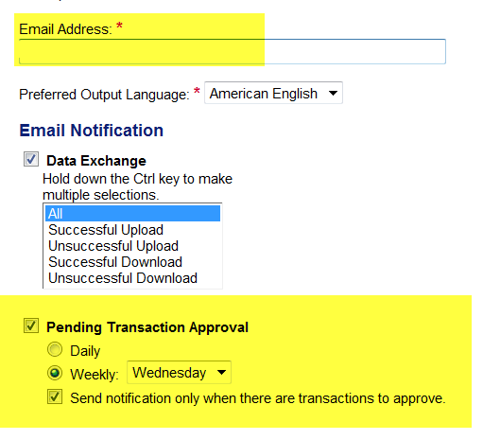
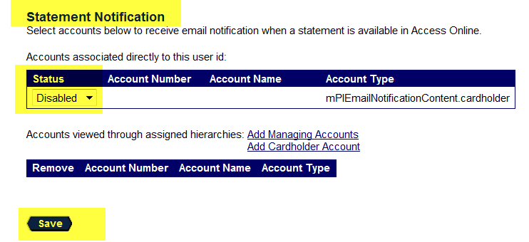
Approving Manager Email Notification
Your email address will default. If not, enter your email address.
Select when you would like to receive notification that you have transactions to approve
Under Statement Notification, change the status from Disabled to Enabled and click Save
1
3
2
After you click Save, the message below will be displayed at the top of the screen.

Slide 14
Transaction Allocation

Slide 15
Transaction Allocation
Includes:
Transaction Allocation
Splitting Transaction
Approving/Forwarding Transactions to Approving Manager
Pulling Back Transactions (as long as the Approving Manager has not approved, rejected, or modified the transaction)
Managing Rejected Transactions (if your Approving Manager sends it back to you )
Disputing & Cancelling a Disputed Transaction

Slide 16
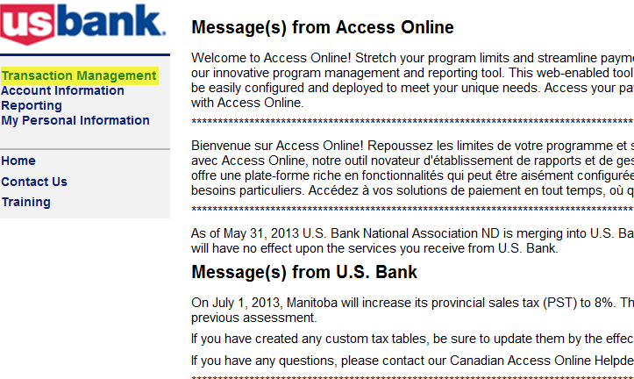
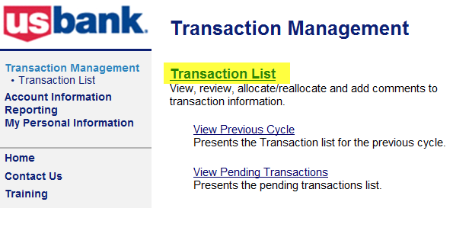
Transaction Allocation
1
2
To view transactions:
1. Select Transaction Management
2. Click Transaction List link under Transaction Management
Note: If you have access to only one account you will be directed to the account after you select transaction management.

Slide 17
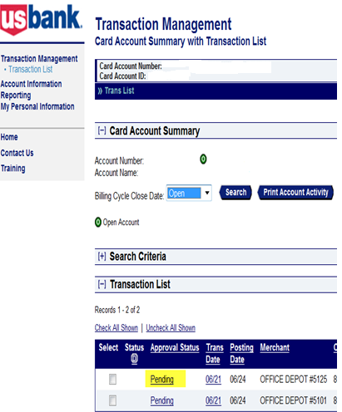
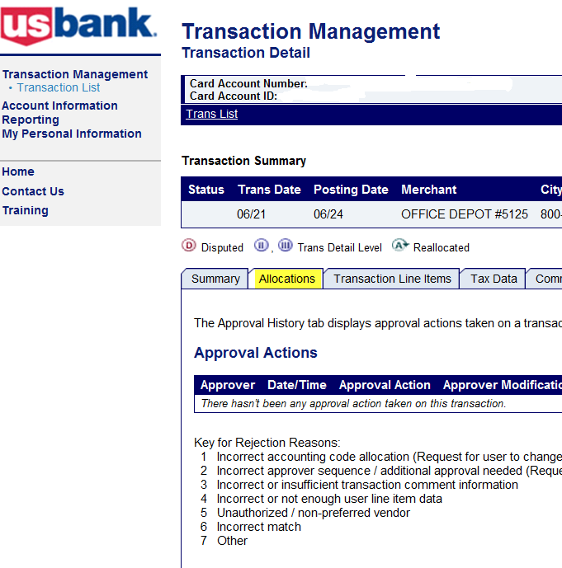
Transaction Allocation
Select Pending next to the transaction you are allocating
Click on the Allocations Tab
….

Slide 18
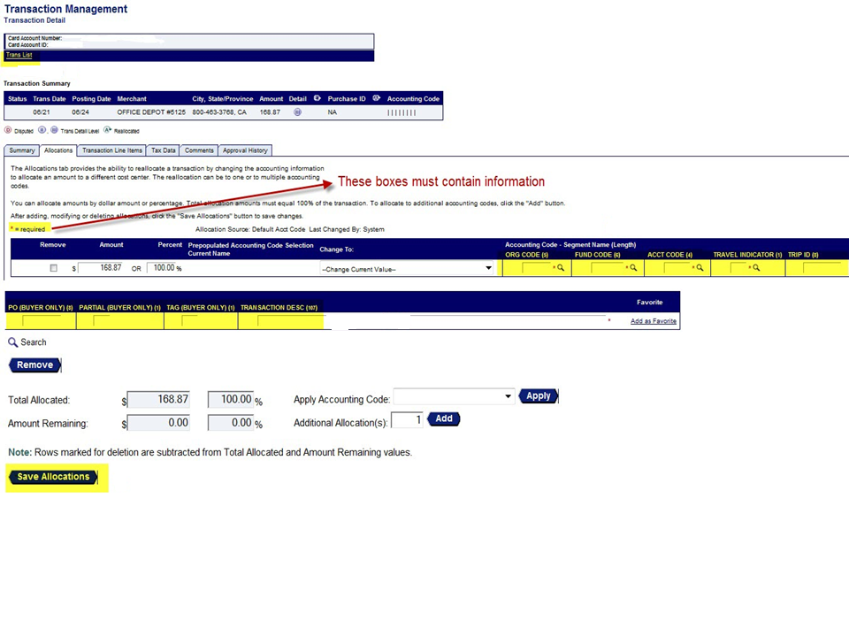
Transaction Allocation
1. Enter in your org, fund and account code. The alpha character for the org and fund should be capitalized.
2. Travel Indicator = If the transaction is travel-related, enter Y. If not, enter N. Trip ID = If you have a trip number, enter in the 8 digit code. If not, leave blank.
1
2
3
4
3. Skip the Buyer Only boxes.
4. Transaction Desc. = a description of what was purchased.
5. Click Save Allocation
6. Select Back to Trans List to return to your list of transactions.
5
6

Slide 19
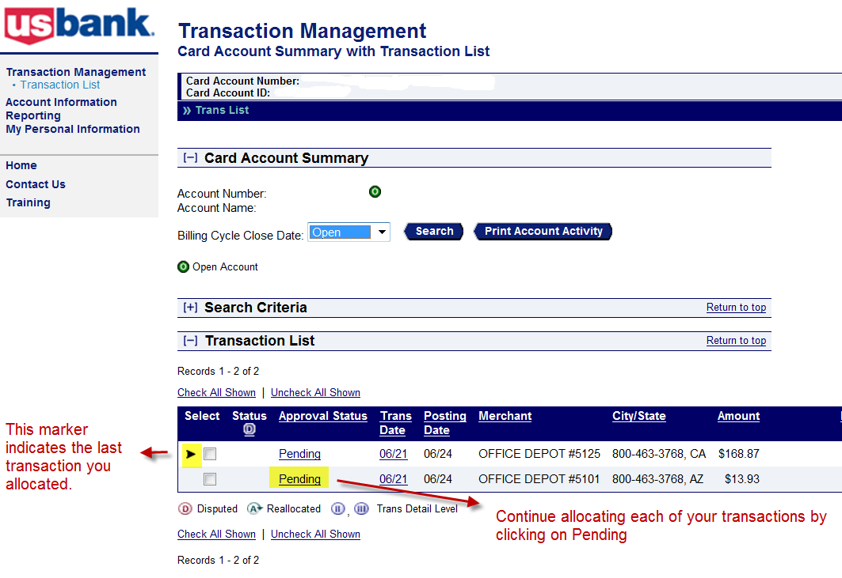
Transaction Allocation

Slide 20
Transaction Allocation
If you are prepared to allocate all of your transactions at one time, you can do so by following the steps below.
From your transactions list, click Check All Shown
Select the Reallocate button

Slide 21
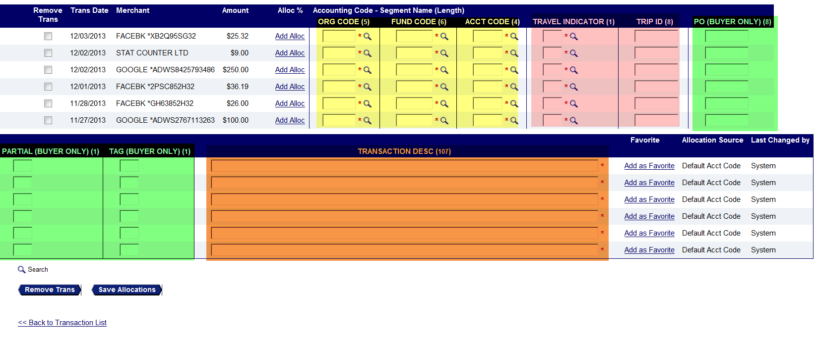
Transaction Allocation
1. Enter in your org, fund and account code. The alpha character for the org and fund should be capitalized (yellow section).
2. Travel Indicator = If the transaction is travel-related, enter Y. If not, enter N.
Trip ID = If you have a trip number, enter in the 8 digit code. If not, leave blank. (pink section)
3. Skip the Buyer Only boxes. (green section)
4. Transaction Description = a description of what was purchased. (orange section)
5. Click Save Allocation

Slide 22
Splitting A Transaction

Slide 23
Splitting A Transaction
Select Pending next to the transaction you would like to split.
Click on the Allocations Tab

Slide 24
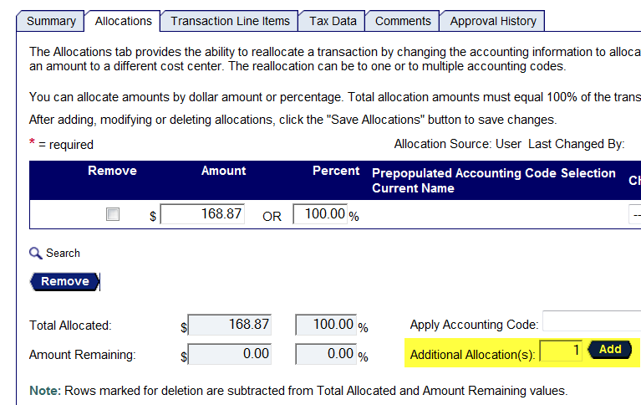
Splitting A Transaction
In the Additional Allocation(s) box, enter in the number of extra allocation lines you need and then Click Add.
….
….

Slide 25
Splitting A Transaction
1
3
2
4
After clicking Add, the additional allocations lines will be displayed.
1. You can either split a transaction based on percentage (%) or amount ($). If you enter in the amount, the system will calculate the percentage for you and vice versa.
2. Enter in your org, fund and account code. Travel Indicator = N and Trip ID = Leave blank. Do not input information in the Buyer Only boxes. Transaction Desc. = a description of what was purchased.
3. The system will verify that the total split amount is equal to the transaction amount.
4. Click Save Allocations

Slide 26
Cardholder - Approving/Forward Transaction(s) to Approving Manager

Slide 27
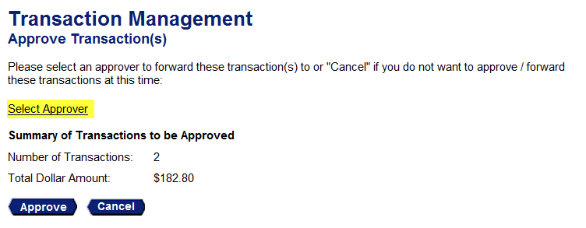
Cardholder - Approving/Forward Transactions to Approving Manager
After you have allocated all of your transactions, they are ready to be forwarded to your Approving Manager for approval.
1. Select the Check All Shown link. A check mark will appear in each box next to each transaction.
2. Click Approve.
1
2
3
3. Click Select Approver to set your default Approving Manager
Note: You will only have to do this step once. This information will default for future transactions.

Slide 28
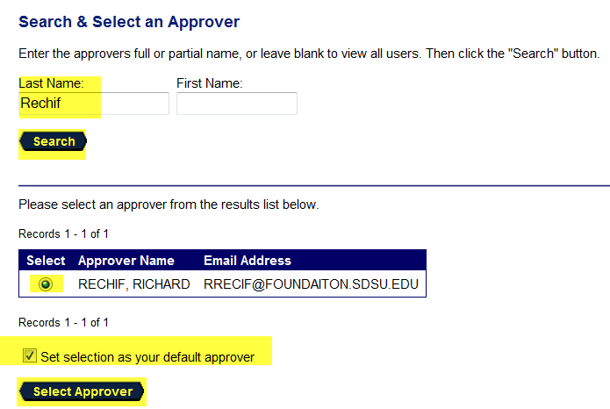
Cardholder - Approving/Forward Transactions to Approving Manager
1
2
3
4
5
1. Enter in your Approving Manager’s last/first name and Click Search.
Note: If you are your own Approving Manager, your screen will default to another option. Select No further approval needed for these transactions. Click Approve.
2. Click the circle next to the Approving Manager’s name.
3. Check the Set selection as your default approver box.
4. Click Select Approver.
5. Click Approve
Note: If you have multiple Approving Managers, follow the same step to add another approver. You can select which one to set as your default Approving Manager.

Slide 29
Pulling Back A Transaction
As a Cardholders, you can pull back a transaction before the Approving Manager you have forwarded the transaction to has approved, rejected, or reallocated it. After an Approving Manager takes action on a transaction, the transaction belongs to the Approving Manager and can no longer be pulled back.
As an Approving Manager, you can pull back a transaction after you reject it, as long as the cardholder has not approved or modified (e.g., reallocated) the transaction.

Slide 30
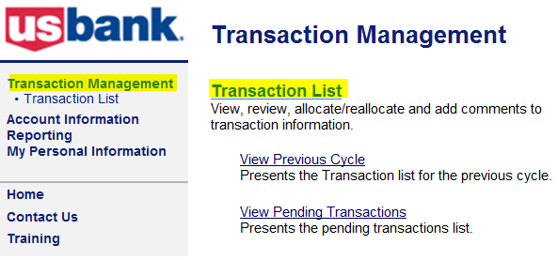
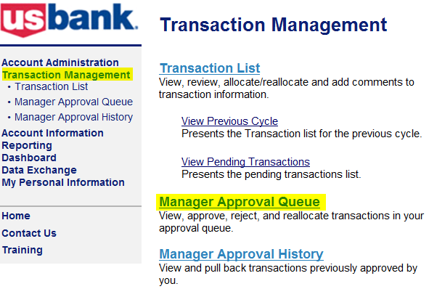
Pulling Back a Transaction
Cardholders:
Select Transaction Management
Click Transaction List
Approving Managers:
Select Transaction Management
Click Manager Approval History

Slide 31
Pulling Back a Transaction
2
3
2. Select the check box for the transaction you wish to pull back.
3. Click the Pull Back button.
The transaction will now read as Pulled Back.

Slide 32
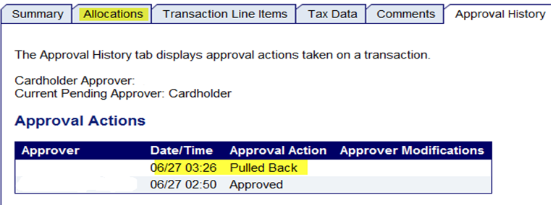
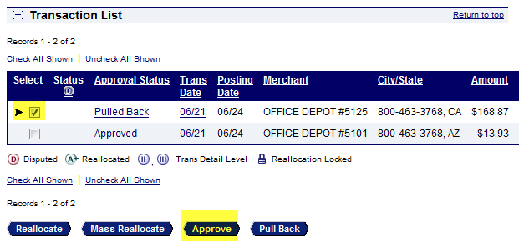
Pulling Back A Transaction
1. Click the Allocations tab
2
2. Change the information you would like to change.
3. Click Save Allocation. Request has been successfully completed will be displayed above the transaction. Go back to the transaction list.
Cardholders:
4. Check the box for the pulled back transaction.
5. Click Approved and follow the transaction approval steps.
3
4
5

Slide 33
Approving Manager Transactions Approval

Slide 34
Introduction
Approving Manager basic user Transaction Approval Process (TAP) function:
1) Approve Transactions. Cardholders review, approve and forward only their own transactions, while Approving Managers review and approve transactions forwarded to them from cardholders.
2) Pulling Back Transactions. Cardholders can pull back transactions that an Approving Manager has not approved, rejected, or modified (e.g. reallocated) yet. Both cardholders and Approving Managers can pull back transactions they previously approved as long as the transaction has not been modified (e.g., reallocated, added comments, changed user line items).
3) Reject Transactions. Approving Managers can reject transactions and send them back to the cardholder. The rejecting Approving Manager must specify a rejection reason so that the cardholder receiving the rejected transaction knows how to manage the rejected transaction.

Slide 35
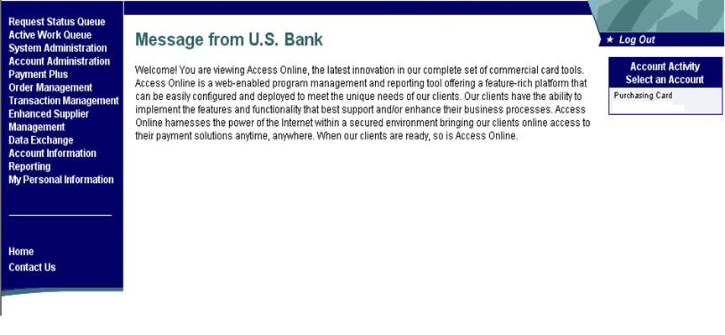
View and Approve Transactions
1
To view and approve transactions:
1. Select the Transaction Management on the left column navigation bar.

Slide 36
View and Approve Transactions
2
2. Select the Manager Approval Queue link.

Slide 37
View and Approve Transactions
You can approve your cardholder transactions by verifying that the account distribution (highlighted on the right) is correct. Or you can click Pending next to the transaction to view the transaction detail in another screen.
This section contains the org code, fund, account code and transaction description. Each item is separated by a /.

Slide 38
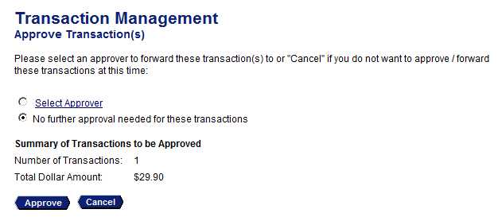
View and Approve Transactions
If you are approving your transactions on the screen below
1. Verify that the accounting distribution is correct for each transaction. If you need to make a change, you will have to click Pending to open the transaction to change any information.
2. Select the Check All Shown Box
3. Click Approve
Note: You can also click on Pending next to any transaction to see the account distribution and approve the transaction in a full screen view.
1
2
4
3
4. After you have clicked approve, you must select the next approver step. Select No further approval needed and then click Approve. Request has been successfully completed will be displayed at the top of the screen.

Slide 39
Approving Manager Transaction Rejection Process

Slide 40
Approving Manager - Reject a Transaction
Note:
You can reject a group of transactions, but it must be for the same reason.
As the Approving Manager, you have the ability to override an account distribution and not reject the transaction.
1
2
To reject a transaction:
1. Select the check box in the Select column for the transaction you want to reject.
2. Click the Reject button. The Transaction Management: Reject Transaction(s) screen displays.

Slide 41
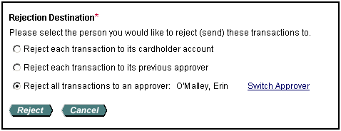
Approving Manager - Reject a Transaction
6. Select the Reject each transaction to its cardholder account radio button
7. Click the Reject button. The Transaction Management: Manager Approval Queue screen will display a confirmation message and the transaction will no longer be in your approval queue.
Please notify the Cardholder when you have rejected one of their transactions. The system does not send a notification to the Cardholder.
3
4
5
3. Select the appropriate Rejection Reason check box(es).
4. If you selected the Other check box, then type comments.
Note: If you select the Other check box, then you must type comments. You can also select more than one reject reason. Add comments to any rejection by selecting Other as well and typing comments.
5. Select the Reject each transaction to its cardholder account option.
6
7

Slide 42
Cardholder - Manage a Rejected Transaction
Your approving manager you forward a transaction to may reject a transaction. When an approving manager rejects a transaction, the system requires the rejecting approving manager to provide a reason and/or comments, so you know how to modify the transaction to make it acceptable. After you modify the transaction, you can re-approve and forward the transaction back to your Approving Manager.

Slide 43
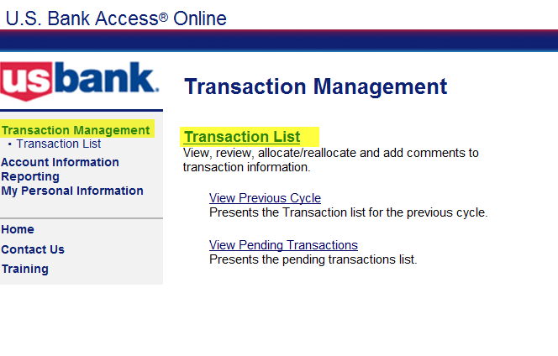
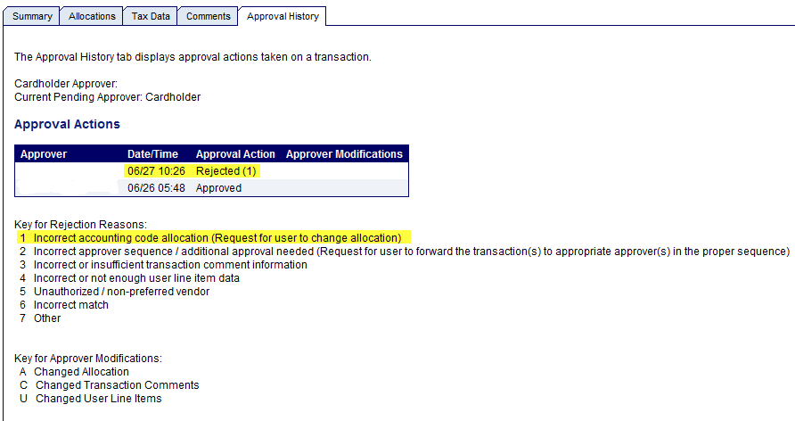
Cardholder Rejected Transactions
Select Transaction Management
Click Transactions List
The rejected transaction information will be listed under Approval Actions.
Use the Key for Rejected Reasons to find the reason the transaction was rejected.
Click on the Rejected transaction.

Slide 44
Cardholder Rejected Transactions
Correct the information based on the rejected transaction reason.
Click Save Allocation. will be displayed above the transaction.
Click Back to Transaction List. You can now send the rejected transaction back to your Approving Manager for approval.

Slide 45
Disputing A Transaction
You can use Access Online to dispute a transaction, including selecting a reason for the dispute. In addition, you can use the system to request a copy of the sales draft to get more information about the disputed transaction. You can also cancel a disputed transaction as long as the disputed transaction is unresolved.

Slide 46
Disputing A Transaction
1
To dispute a transaction:
Click the Transaction Date link for the transaction you want to dispute.

Slide 47
Disputing A Transaction
2
2. Click the Dispute button. The Transaction Management: Select a Dispute Reason screen displays.

Slide 48
Disputing A Transaction
3
4
3. Select the button for the appropriate dispute reason.
4. Click the Select button. The Transaction Management: Dispute Reason screen displays, listing your selected dispute reason.

Slide 49
Disputing A Transaction
5
6
7
8
Note: The Transaction Management: Dispute Reason screen has different fields depending on the dispute reason selected.
5. Verify or type your name in the Requestor Name field.
6. Type your phone number in the Requestor Phone Number field.
7. In the Comments box, enter additional comments to explain why you are disputing the charge.
8. Click the Continue button. The Transaction Management: Dispute Reason screen displays with a message at the top confirming that your request has been completed.

Slide 50
Disputing A Transaction
9. Follow the instructions on the screen to print, sign and fax or mail this form to US Bank.
NOTE: IF YOU DO NOT FOLLOW THIS STEP,
YOUR TRANSACTION WILL NOT BE DISPUTED.

Slide 51
Cancel A Dispute
You can easily cancel an unresolved dispute. If you cancel a dispute, keep in mind that the transaction is automatically settled in favor of the merchant. After you cancel a dispute, you can also re-dispute the transaction.

Slide 52
Cancel A Dispute
1
To cancel a disputed transaction, navigate to the Transaction List screen.
1. Click the Transaction Date link for the transaction you want to dispute. The Transaction Management: Transaction Detail screen displays with the Summary tab open.
Note: Disputed transactions display with a D icon to indicate that they were disputed. The D icon remains even after the dispute has been resolved or cancelled.

Slide 53
Cancel A Dispute
2
3
2. Review the dispute detail and make sure the Dispute Status is Unresolved.
3. Click the Cancel Dispute button. A confirmation message displays.

Slide 54
Cancel A Dispute
4
5
4. Type comments in the Cancellation Comments field. You have up to 40 alphanumeric spaces for your comments.
5. Click the Yes, Cancel Dispute button. You return to the Transaction Management: Transaction Detail screen with the Summary tab open.

Slide 55
Cancel A Dispute
Note: If you need to, you can re-dispute the transaction by repeating the steps in Dispute a Transaction.

Slide 56
Account Activity Report
The Account Activity Report provides the Cardholder and Approving Manager a snapshot of monthly transactions which includes allocation information for each transaction.
This report should be generated after all of the transactions have been allocated in order to display the allocation information on the report.
The Account Activity Report is to be submitted monthly with the original receipts.

Slide 57
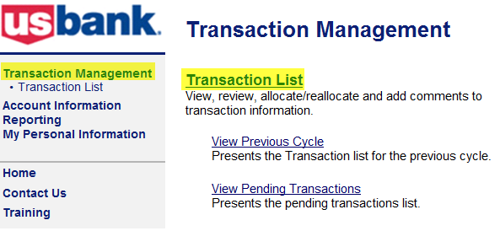
Account Activity Report
Select Transaction Management
Select Transaction List
3. Select Billing Cycle Close Date for appropriate month.
4. Click Print Account Activity

Slide 58
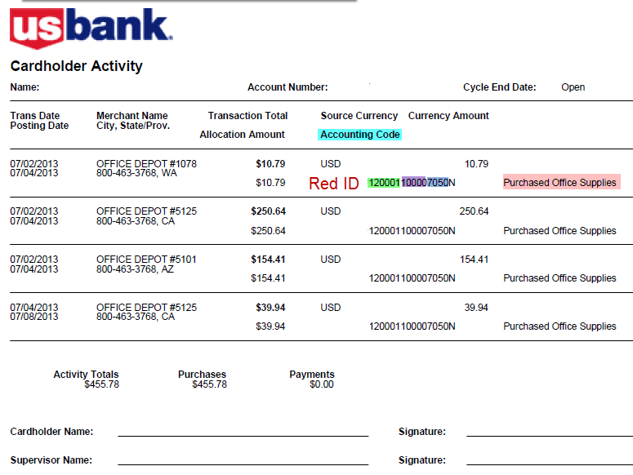
Account Activity Report
Under the Accounting Code section, the Cardholder’s Red ID number, org code, fund, account code, N for Travel Indicator and transaction comments will be displayed.
This form does not need to be signed.

Slide 59
Submission of Paperwork
Cardholders must submit the following documentation (once a month) when there are purchases :
Account Activity Report
All original receipts and supporting documentation
If you are missing a receipt, the lost receipt form (which can be found on the Foundation’s website under PCard Program) must be submitted for each transaction without a receipt.
Submit electronic packets to sdsurfpcard@sdsu.edu or via mail to Procurement Card Administrator at MC 1941
Note: If you are using a copier to scan your remittance packet and cannot change the file name, input the information (cardholder’s last name and month transactions occurred) in the subject line. Also, you must keep the hard copy for 90 days after fiscal year end.

Slide 60
US Bank PCard Deadlines 2015
Overview
PCard transactions are captured and visible in US Bank’s AccessOnline system, usually within 24-48 hours of the transaction. Cardholders and Approving Managers review transactions, allocate to the appropriate accounting strings (FOAP’s) and approve. After transactions have been reviewed and approved, they are extracted from the US Bank system and posted to the appropriate expense accounts in the Banner Finance system.
Files will be extracted for posting twice per billing cycle. The SDSURF program billing cycle runs the 28th of each month through the 27th of the following month.
Mid-Cycle Extract
The First Extract will occur mid-cycle. This extract will capture all transactions that have been reviewed and allocated by cardholders AND approved by the approving manager. This extract is intended to support more frequent posting of transactions for those cardholders and approving officials who choose to process transactions throughout the month. This will also enable the high volume of transactions processed by SDSURF buyers to post twice a month (currently posted once a month). Once transactions are flagged for extract, they will be locked and can no longer be edited in Access Online.
End-of-Cycle / Cycle Close Extract
The second extract of the month will occur approximately five business days after the billing cycle closes. This extract will capture all transactions, except those extracted and flagged in the mid-cycle extract, in the current billing cycle. All cardholders and approving managers MUST review, allocate and approve transactions within five business days after the cycle close date. If there are transactions that are not complete, they will be extracted and routed to the appropriate administrator in the edit process for research and resolution within the three business day processing cycle for administrative follow up on suspended transactions. Transactions still not allocated and approved will be posted to a suspense account until they are resolved. Cardholders with items in suspense > 60 days will automatically have their cards suspended until the items are resolved.

Slide 61
US Bank 2015 Deadlines
The billing cycle opens the 28th of each month and closes the 27th of the following month.
Transactions usually post within 2-3 days of purchase. Cardholders can allocate, approve and forward their transactions to the Approving Manager upon posting
in Access Online.
After receiving the email notification of available transactions,
Approving Managers can approve transactions. Transactions must be allocated by close of business for each date listed on the deadline schedule.

Slide 62
Cardholder & Approving Manager Responsibilities
It is very important for all cardholders and approving managers to meet their responsibilities in a timely manner. The following is a list of program violations that will trigger review of cardholder and approving manager readiness to participate in the program per the schedule of corrective action below.
Late or incomplete submission of monthly remittance packets, including packing slips, receipts, supporting documentation, etc.
Late allocations and approvals in Access Online
Purchase of prohibited items (Refer to Section IV of Procurement Card Policy & Procedure Manual )
Not allocating expenses correctly to reflect grants/project benefited by the purchase(s)
Overspending grants, causing fund deficits
Failure to submit a T-1 Form in advance of using PCard for travel related purchases
Use of the PCard for purchases of more than the preset spending limit by splitting the purchase into more than one transaction is not allowable.
Failure to return the PCard when reassigned, terminated, or upon request

Slide 63
Cardholder & Approving Manager Responsibilities
Schedule of Progressive Corrective Actions
1st Incident | Approving manager and cardholder will be provided with a warning and a resolution date. If not resolved by the date SDSURF reserves the right to charge expenses to any discretionary funds available and the card(s) limits may be set to $1 until resolved.
2nd Incident | Approving manager and cardholder will be provided with a warning and a resolution date. If not resolved by the date SDSURF reserves the right to charge expenses to any discretionary funds available and the card(s) will be temporarily suspended until resolved. Card limits and spending privileges may be reviewed and adjusted to a more conservative spending limits and profiles
3rd Incident | If the 3rd incident occurs within 12 months of the 2nd incident and warning, the PCard is revoked for a period of no less than three months and up to 12 months. Any outstanding expenses may be charged to discretionary fund(s). Cardholder and Approving manager must reapply for a card and attend training again. In the case of deficit spending, the PI/PD may be required to provide a discretionary fund, or if they do not have one, may be required to obtain Dean sponsorship.
Immediate Revocation | Cards will be immediately revoked for: Allowing other individuals to use one’s PCard Using the PCard for personal purchases/non-business related expenses Fraudulent use of the PCard

Slide 64
Billing and Shipping Address
Billing Address
SDSU Foundation
5250 Campanile Dr.
San Diego, CA 92182
Shipping Address
SDSU RESEARCH FOUNDATION RECEIVING Attn: Cardholder’s full name, phone number, building, and room number
SDSURF Receiving 5555 Canyon Crest Drive San Diego, CA 92182

Slide 65
Resources Available To You
Access Online Help Desk – (877) 887-9260
- General Website Navigation Inquiry
- Resetting Passwords
- General Account Inquiry
24-Hour Customer Service- (800) 344-5696
- Balance Inquiry
- Statement Inquiry
- Disputed Items
- Declined Purchases
- Card Activation
- Lost, Stolen or Compromised Card
SDSURF Procurement Card Administrator
(619) 594-5622 or sdsurfpcard@sdsu.edu

