Slide 1
Workforce Time & Attendance Training

Slide 2
After this training, you will be able to:
Access Workforce and navigate through the system as a manager/supervisor.
Understand the importance of timesheets and recording meal breaks.
Review, approve, edit, and submit employee timesheet information for your employees within the approval deadlines.
Delegate/revoke approval authority to other supervisors.
Manage employee groups & process Time Off Requests (TORs.) within Workforce.

Slide 3
Supervisor’s Role & Responsibilities in Workforce

Slide 4
All employees and supervisors record and approve time worked in the electronic time and attendance system, Workforce. Employees and supervisors may complete and approve timesheets from any computer or mobile device with web access.

Slide 5
Supervisor’s Role “Supervisor” is defined as any employee who has the authority to lead, direct, or schedule another employee. In Workforce, the supervisor is the person who has reasonable knowledge of hours worked and is responsible for reviewing employee timesheets and certifying the following:

Slide 6
That the employee has accurately recorded all time worked. That all exceptions (i.e. vacation, sick leave, jury duty, etc.) are listed for the pay period. That distribution of the corresponding salaries and wages for the effort listed is reasonable to be charged based on the funds and distribution percentages listed under “Expense Distribution” in relation to work performed, or that action has been taken to initiate the appropriate corrections to ensure the payroll distribution is reallocated to reflect a reasonable distribution in relation to the work performed.

Slide 7
Accessing the Workforce Dashboard

Slide 8
Accessing Workforce https://sdsurf.wtaus8.wfs.cloud/workforce/SSO.do
Go to the SDSURF website: https://www.foundation.sdsu.edu/
Hoover over “Quick Links”
At the bottom of the list there are three links to Workforce
1st Link to Workforce - to access while using Workforce on a desktop or laptop computer
2nd Link to Workforce - to access while using Workforce on your phone
3rd Link to Workforce - is for users who are blind or have low vision
Notes:
Your Workforce Username is your SDSU ID.

Slide 9
Manager’s Dashboard
Notes:
When you log into Workforce, you will be taken to your Manager Dashboard. The manager dashboard offers functions not available to employees that are designed to assist supervisors in managing employee time. Managers can use these options to edit and approve employee timesheets, and review and approve employee time off requests.
Your Manager Dashboard consists of 6 primary blocks: Time Entry, Reports, Employees, Resources, Schedules and Settings.
In the Time Entry block you can view, enter or update your timesheet data and your employee’s timesheet data
The Reports block allows you to view and generate reports, view timesheet information for a certain period and view delegated roles or comments on timesheets.
The Resources block will link you to the SDSURF Workforce Resources page
In the Schedules block you can manage and track your individual time off requests and review time off requests submitted by your employees. You also have the ability to assign and manage schedules for hourly employees.
Settings block gives you the capability change your password and delegate supervisory responsibility to another manager.
The Dashboard also includes 2 secondary blocks which enable you to view your leave balances and time off requests
Other information available on your dashboard includes your name, position number and your supervisor’s name

Slide 10
Employee Timesheets in Workforce

Slide 11
To comply with legal timekeeping requirements and grant regulations, it is essential that supervisors:
Ensure employees submit their timesheets for approval every pay period.
Approve employee timesheets by the established deadline. Timesheet deadlines are on the website at SDSURF - Calendars/Deadlines - Pay Dates and Deadlines https://www.foundation.sdsu.edu/calendars_pay_dates.html
Approve timesheets for your non-exempt employees who did not work and reported no hours worked.
Contact your HR Business partner by email at sdsurfhr@sdsu.edu if your employee is no longer working for SDSURF.

Slide 12
Timesheets – Why are these important?
Under the Fair Labor Standards Act (FLSA), timesheets are a legal requirement. They are the source of payroll transactions. They serve as a legal basis to ensure that the employees receive the compensation, benefits, and time off they’re entitled to, and this information must be complete and accurate.

Slide 13
Approving Employee Timesheets
Notes:
Managers can approve timesheets for individual employees or for an entire group. To access employee timesheets select “Approve Timesheets” option from the Time Entry Window.
Mangers can see the status of employee timesheet in the secondary blocks on the bottom right. The status column indicates which employee timesheets have been approved.

Slide 14
Approving Employee Timesheets
All employees or groups that are assigned to you will appear in the window.
Select the group of employees whose timesheets you want to review from the groups listed under Assignments
The employee timesheets will populate on the right side of the screen
(6)
Notes:
Your group(s) of active employees as of the current pay period will be listed on the left side of the screen. Under Assignments, select the group of employees whose timesheets you wish to review. SDSURF Supervisor has one group of 6 employees assigned to them.
There will always be a default group of all employees that you supervisor. There will only be additional options if you have setup new groups which will be explained later on in the training.
If an employee is listed that you do not supervise and should not be on your list, please contact HR and/or your SRA Administrator to have it be corrected.

Slide 15
Approving Employee Timesheets
Employee timesheets are grouped by type of position
Timesheet submitted column indicates what timesheets are ready for review
Notes:
This screen summarizes the details of the timesheets that you need to review and approve so that your employees will receive a paycheck. Supervisors are responsible for reviewing and approving employee timesheets by payroll deadlines. **System generated emails will be sent out to remind you to review/approve your employee’s timesheets.
Timesheets are grouped by Exempt and Non-Exempt positions.
The timesheet submitted column indicates which employees have submitted their timesheets for your review and approval. The “Exceptions” column indicates if there is an issue on the timesheet that needs review or action prior to approval.
Click anywhere on the row of the employee whose timesheet you want to review.

Slide 16
Approving Employee Timesheets
In this example, the employee exceeded the standard hours and missed an in or out time.
Notes:
If there is an “exception to the norm” a pin icon will appear on the timesheet on the day the exception occurred.
The Exceptions tab at the bottom of the timesheet will provide detailed information for your review
In this example, the employee exceeded the standard daily hours of eight hours and missed an in or out time. If an hourly employee has an appointment to work 10 hours per week, Workforce will divide the 10 hours over the five work days in the week. Any deviation will prompt an exception message.
The yellow exception message does not require any action other than review on the part of the manger.
The red exception message does require action from the manager before the timesheet can be approved.
Once supervisor review is completed, click the certification statement box under Exception Message on each time report.

Slide 17
Exception Messages
The “Exceptions” area at the bottom of the timesheet will note issues with an employee timesheet.
Exception messages are color-coded to identify the level of severity:
White: No exceptions or only informational messages present
Yellow: Warnings present
Red: Errors present
Errors (Red) must be corrected prior to approving employee timesheets.

Slide 18
Approving Employee Timesheets
Points to consider while reviewing employee time sheets for approval or rejection:
Exempt employees: Will be logging only exceptions to their regular time. (I.E., time off – vacation, sick, jury duty, leaves etc.)
Non‐exempt (hourly) employees: Will be logging work in and out times (work start/end as well as lunch/meal breaks if applicable) rather than the number of hours worked that day. The system will automatically calculate the number of hours worked as well as paid time off (if applicable to the employee’s job classification.)
ZERO hours‐ time sheets If an hourly/non‐exempt employee did not work any hours during the pay period, the time sheet should still be submitted without any hours logged. It’s not necessary for the employee to submit their time sheet but the supervisor should approve and submit the time sheet without any time logged.

Slide 19
Approving Employee Timesheets
If timesheet is accurate, click on the “Approve Box”
Select “Save Approvals” to finalize and submit timesheet
Notes:
If the time reported by the employee is accurate and the supervisor certification statement has been checked on the time report, click on the “Approve” box in the Supervisor Approval column to approve the individual employee timesheet.
Select “Save Approvals” to finalize the timesheet. When the employee opens his/her timesheet, a note appears informing them that the hours have been approved.
Supervisors can also review timesheets for all employees and when use “Approve All” to approve timesheets for the group of employees. This will not work if there are any errors or exceptions that need to be corrected.

Slide 20
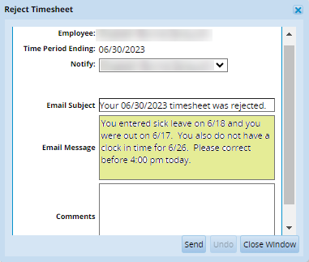
Rejecting a Timesheet
If the timesheet has errors, the supervisor can “Reject” and send back to the employee for corrections
Employee will get an email message
Supervisor should follow up with the employee because if the timesheet is left unchanged, it will be paid out as the employee last submitted it.
Notes:
If there is an error on the timesheet, supervisors should reject the timesheet to re-route back to the employee. The employee can make the requested corrections and re-submit his/her timesheet for approval.
To reject a timesheet, click on the red button in the Supervisor Approval column.
The Reject Timesheet window will prompt you to enter a message to the employee regarding the reason the timesheet is being rejected and action that needs to be taken to correct any errors. Hit sent to reject the timesheet.
The employee will receive a notification via email that will include the message you input.

Slide 21
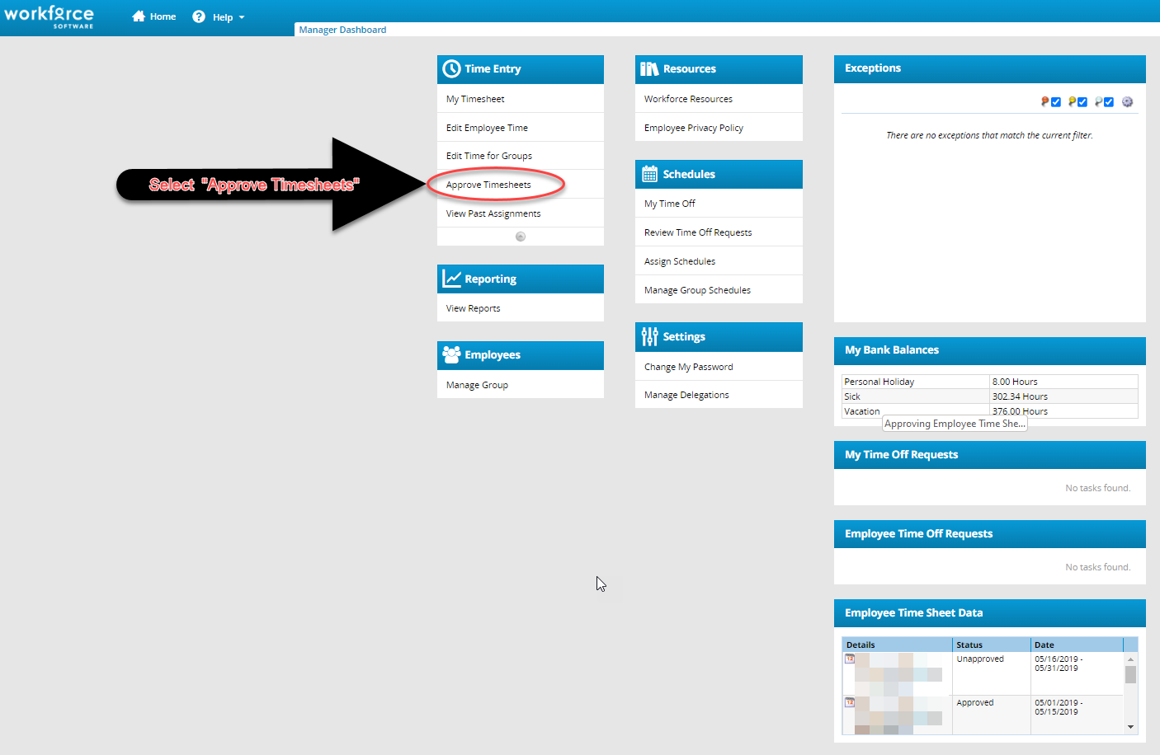
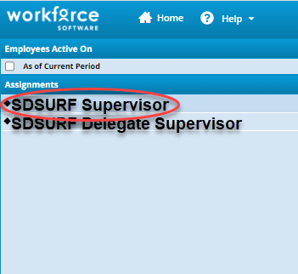
Amending a Timesheet from a Prior Pay Period
Login to Workforce https://sdsurf.wtaus8.wfs.cloud/workforce/SSO.do
Click on “Approve timesheets”
On the left side of the screen, under “Assignments” click on your name to call up the list of your employees
Notes:
If a previously approved and paid timesheet needs to be revised, the supervisor should handle it through the “Amend” process.
There are two reasons for amending a time sheet.
1. After a pay period is closed and processed you receive an email from SDSURF that timesheets from a prior pay period are missing your approval, or;
2. If an adjustment is required on an employee’s time sheet for a prior pay period. In this case, have the employee follow the instructions “How To Amend, Certify and Submit a Prior Pay Period Time Sheet”. Note that you will need to approve the amended time sheet before it can be processed.

Slide 22
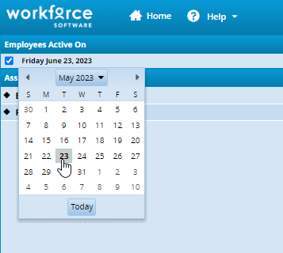
Amending a Timesheet from a Prior Pay Period
In the upper left corner, click to put a checkmark in the little grey box to access the calendar pop-up
For each of your employees you will see “Timesheet is closed” for that person, click on their name to pull up the timesheet
Notes:
(NOTE: on a Mac your browser's pop-up blocker should be set to allow pop-ups to access the calendar pop-up) and select the applicable work period. )

Slide 23
Amending a Timesheet from a Prior Pay Period
Click on the “Amend” button
Review (edit if needed) the Timesheet then click the “Save and Close” button

Slide 24
Amending a Timesheet from a Prior Pay Period
Put a checkmark in the “Approve” checkbox in the “Supervisor Approval” column.
Click the “Save Approvals” button

Slide 25
California Law – Meal Breaks Non-Exempt (hourly) employees
Work more than 5 Hours:
If your employee works over 5 hours in a day, they must be provided at least a 30 minute unpaid meal break that must start before the beginning of the fifth hour of their shift. BUT they can agree to waive this meal period provided they do not work more than 6 hours in the workday. They will need to fill out a Meal Waiver Form and give it to you, so you can sign it and send it to the payroll department.
Work more than 10 Hours:
If your employee works over 10 hours in a day, they must be provided at least a 30 minute unpaid meal break that must start before the beginning of the tenth hour of their shift. They can agree to waive the second meal break if they do not work more than 12 hours and they did not waive your first meal break.
The employee is owed one hour of pay if the employee is unable to take a meal break.

Slide 26
Timesheet Comments
Supervisors can submit notes and changes to Payroll on the employee’s time reports.
This can be done if overtime hours should post to a different fund, if an employee is setup on the wrong fund, or if a different fund distribution is needed for the timesheet.
Supervisor would write in the comment and must click the “Submit Comment to Payroll” box to submit to Payroll. (If box is not checked, message does not get submitted.)
Notes:
If a supervisor needs to make a fund number distribution change to a timesheet, they can use the Comment Box in the timesheet. Payroll will make the change in the system and will contact HR and the SRA administrator as needed for any additional approvals or corrections that need to be made on Pass Sheets, etc.

Slide 27
Supervisor’s Deadlines for Timesheet Approval

Slide 28
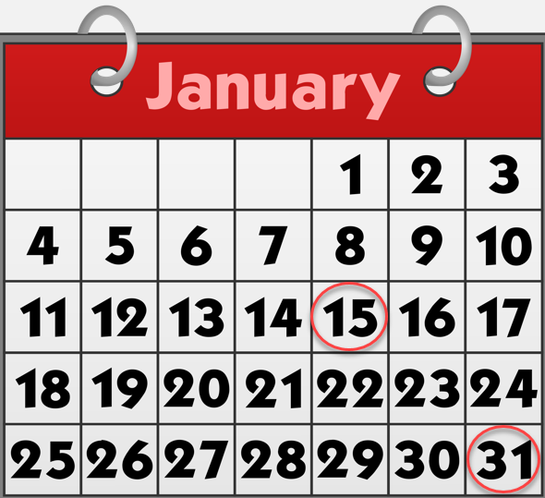
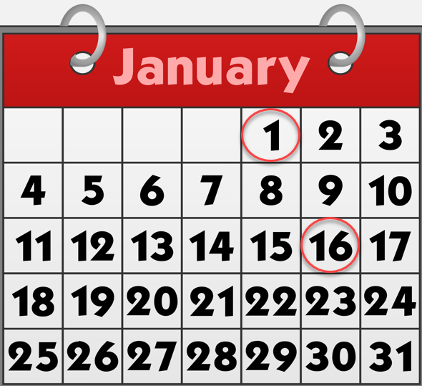
Supervisors are responsible for the summitting and approving of timesheets within published deadlines
Supervisors are responsible for their employees submitting of timesheets. Employee’s timesheets are due on the 15th and last day of the month.
Supervisors must approve timesheets on the 1st and the 16th of the month. If the 1st or 16th day of the month falls on a weekend or holiday, the timesheets must be approved on the next business day.

Slide 29
Where can I find the deadlines for approving timesheets?
https://www.foundation.sdsu.edu
Employees
Calendars/Deadlines
Pay Dates and Deadlines

Slide 30
Payroll Period | HR Paperwork Due to SRA Administrator | Timesheet Submitted to Supervisor by End of Day | Timesheet Supervisor Approval Deadline by Close of Business | Pay Date
December 1 - 15, 2022 | Dec. 1, 2022 | THUR Dec. 15 | FRI Dec. 16 | Dec. 23
Dec. 16 - 31, 2022 | Dec. 15, 2022 | SAT Dec. 31 | TUE Jan. 3, 2023 | Jan. 10, 2023
January 1 - 15 | Dec. 30, 2022 | SUN Jan. 15 | TUE Jan. 17 | Jan. 25
January 16 - 31 | Jan. 17 | TUE Jan. 31 | WED Feb. 1 | Feb. 10
February 1 - 15 | Feb. 1 | WED Feb. 15 | THUR Feb. 16 | Feb. 24
February 16 - 28 | Feb. 16 | TUE Feb. 28 | WED March 1 | March 10
March 1 - 15 | March 1 | WED March 15 | THUR March 16 | March 24
March 16 - 31 | March 16 | FRI March 31 | MON April 3 | April 10
April 1 - 15 | March 30 | SAT April 15 | MON April 17 | April 25
April 16 - 30 | April 17 | SUN April 30 | MON May 1 | May 10
May 1 - 15 | May 1 | MON May 15 | TUE May 16 | May 25
May 16 - 31 | May 16 | WED May 31 | THUR June 1 | June 9
June 1 - 15 | June 1 | THUR June 15 | FRI June 16 | June 23
June 16 - 30 | June 15 | FRI June 30 | MON July 3 | July 10
July 1 - 15 | June 30 | SAT July 15 | MON July 17 | July 25
July 16 - 31 | July 17 | MON July 31 | TUE Aug. 1 | Aug. 10
August 1 - 15 | Aug. 1 | TUE Aug. 15 | WED Aug. 16 | Aug. 25
August 16 - 31 | Aug. 16 | THUR Aug. 31 | FRI Sept. 1 | Sept. 8
September 1 - 15 | Aug. 31 | FRI Sept. 15 | MON Sept. 18 | Sept. 25
September 16 - 30 | Sept. 15 | SAT Sept. 30 | MON Oct. 2 | Oct. 10
October 1 - 15 | Oct. 2 | SUN Oct. 15 | TUE Oct. 17 | Oct. 25
October 16 - 31 | Oct. 16 | TUE Oct. 31 | WED Nov. 1 | Nov. 9
November 1 - 15 | Nov. 1 | WED Nov. 15 | THUR Nov. 16 | Nov. 22
November 16 - 30 | Nov. 15 | THUR Nov. 30 | FRI Dec. 1 | Dec. 8
December 1 - 15 | Nov. 30 | FRI Dec. 15 | MON Dec. 18 | Dec. 22
December 16 - 31 | Dec. 15 | SUN Dec. 31 | TUE Jan. 2, 2024 | Jan. 10, 2024
2022 - 2023 Pay Dates and Deadlines

Slide 31
Supervisor’s Certification of Timesheets

Slide 32
Non-Exempt Employees:
Supervisor Certification:
I hereby certify that to the best of my knowledge
this employee has worked the time and effort reflected and any exceptions are listed for the pay period indicated,
the employee was not allowed to work any time that is not recorded, and
legally entitled rest periods were made available to the employee and meal breaks were provided and accurately reported.
I further certify that the distribution of the corresponding salaries and wages for the hours listed is reasonable to be charged based on the funds and distribution percentages listed under Expense Distribution in relation to work performed, or that I have initiated the appropriate corrections to ensure the payroll distribution is reallocated to reflect a reasonable distribution in relation to the work performed.

Slide 33
Exempt Employees:
Supervisor Certification:
I hereby certify that to the best of my knowledge
this employee has worked the time and effort reflected and any exceptions are listed for the pay period indicated,
2) the employee was not allowed to work any time that is not recorded, and
3) legally entitled rest periods were made available to the employee and meal breaks were provided and accurately reported.
I further certify that the distribution of the corresponding salaries and wages for the hours listed is reasonable to be charged based on the funds and distribution percentages listed under Expense Distribution in relation to work performed, or that I have initiated the appropriate corrections to ensure the payroll distribution is reallocated to reflect a reasonable distribution in relation to the work performed.

Slide 34
Supervisor’s Delegation/Revoking of Authority

Slide 35
Delegation of Authority
Delegation is the act of granting someone else authority over your group of employees, typically when you are not available.
Managers must delegate to an individual who is trained to review and certify timesheets for employees. (An employee cannot approve their own timesheet.)
Delegation can be given to for a specific group of employees on an on-going basis
Delegation can be given for a set period of time (e.g. while supervisor is out of the office)

Slide 36
Delegation of Authority
To delegate, from your dashboard select Settings > Manage Delegation.
Select Delegate Authority.

Slide 37
Delegation of Authority
This will bring up a search screen – simply click on the “Search” button and it will retrieve a list of all groups set up with you as named supervisor.
Notes:
The Enter Search Criteria Window appears. This window allows you to search for one or more assigned groups. You can enter a character string and/or the wildcard character (*) to retrieve a list of groups.
Enter search criteria in the group description box to bring up a list of your assignment groups. If you are delegating your assigned group, then enter nothing in this field.
Click “Search”
A window listing the assigned groups matching the search and your role for each group will appear.
In the assignment column, select the check box next to the group name.
In your Role Column, use the drop-down menu to select the role you’ll give to the delegate.
In the effective date and end effective date columns, enter the dates of the delegation. Enter 12/31/3000 if you want to delegate on an on-going basis.
Do not check the box allowing for re-delegation of authority to another user. If this box is checked the system will allow the person you delegate to re-delegate without your knowledge. Best Practice is to NEVER check the “Allow to Re-delegate” checkbox.
Hit “Next”

Slide 38
Delegation of Authority
Click on the box which contains the group you wish to delegate.
Enter the date the delegation is effective and the end date. If you wish to keep the delegation of authority on an ongoing basis, use 12/31/3000 as the end date.
Then click on the “Next” button.

Slide 39
Delegation of Authority
This will bring up the screen where you indicate the person to whom you are delegating authority to approve timesheets. Note: you cannot delegate authority to an individual to approve their own timesheet. The delegation should be to someone who has had training on how to review/approve timesheets and has a “Supervisor Agreement” form on file with SDSURF.
Enter the first and last name of the person to whom you wish to delegate authority. Then hit the “Search” button.
Notes:
Enter the name or user ID of the person you want to delegate to. You can also use the * wildcard and to search.

Slide 40
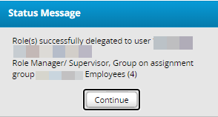
Delegation of Authority
A list of name(s) will appear.
If there are multiple names – click on the circle to the left of the name and then click on the “Select” button.
You will receive a message that the delegation has been successful.
Notes:
Select your delegate from the search results
A message will pop up stating the delegation was successfully completed

Slide 41
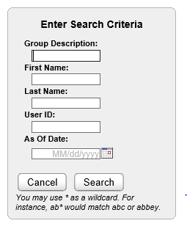
Revoking Delegation
Select “View/Revoke My Delegations” from the dashboard
Search to bring up list of your delegates

Slide 42
Revoking Delegation
Select “Revoke”
Select “Revoke All” (if shown) to cancel all delegations
Notes:
A window appears that list the roles currently delegated within your assigned groups.
Select cancels the delegation in the row that it appears. Selecting Revoke All (if shown) cancels all delegations for the group.

Slide 43
Revoking Delegation
Will receive confirmation “Operation performed successfully”.

Slide 44
Supervisor Management in Workforce

Slide 45
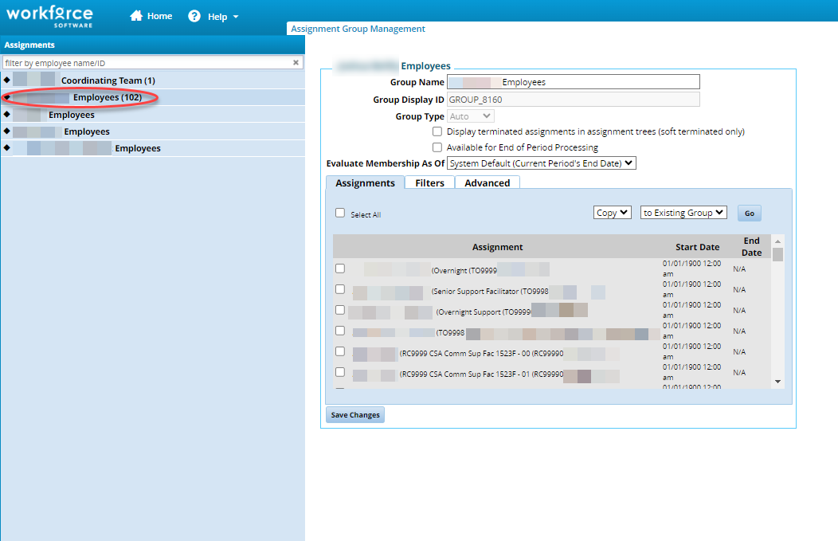
Managing Employee Groups
Select Manage Groups from the dashboard
Click on the group name to bring up list of all employees
Notes:
From the Dashboard, select Manage Group in the Employees block to bring up your employee assignments
Click on the group of employees under the Assignments column to bring up a list of all employees in the group.

Slide 46
Managing Employee Groups
Select Employees for new group
Select Copy, to New Group
“Go”
Notes:
If you have a large number of employee reporting to you and you want to group them together so that you can easily manage different teams or delegate supervision for a team to another supervisor. You can create different groups of employee assignments.
To create a new group of employees to select the employees for the new group by clicking the box next to the employee job. In this example, we are creating a new group for all of Manny Job’s assignments.
From the drop down menus select COPY to New Group
Hit Go

Slide 47
Managing Employee Groups
Notes:
Group name will show as Copy Of….
Change to new group name
Save change

Slide 48
Managing Time Off Requests
Workforce can also be used to request and manage time off requests (TORs).
If you choose to use this functionality, employees can submit time off requests, track the status of requests and view the history of past requests.
Managers can approve or reject TORs, review employee leave balances and TOR history.
Workforce generates email messages to alert Managers to new requests.
Workforce generates email message to notify employees that a request was approved or rejected.

Slide 49
Managing Time Off Requests
Pending requests will appear in the “Employee Time Off Requests” block on your dashboard.
Access pending requests by selecting “Review Time Off Requests”

Slide 50
Managing Time Off Requests
Select the request you want to review by clicking on it.

Slide 51
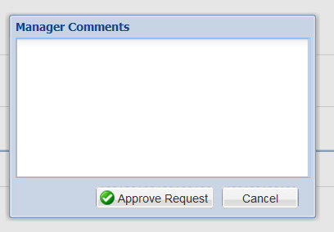
Managing Time Off Requests
Click “Approve” or “Reject” and enter a message to the employee in the Manager Comments box
Click “Approve” or “Reject” to send email to employee
Enjoy your time off!
Notes:
1. Managers can also cancel a previously approved request by opening the request and following the Workforce prompts for information to cancel the request and notify the employee regarding the reason for cancellation.

Slide 52
Questions?

Slide 53
Final Notes for Supervisors
A Supervisor Agreement and instructions for submitting it to SDSURF will be sent to you via email after this training

Slide 54
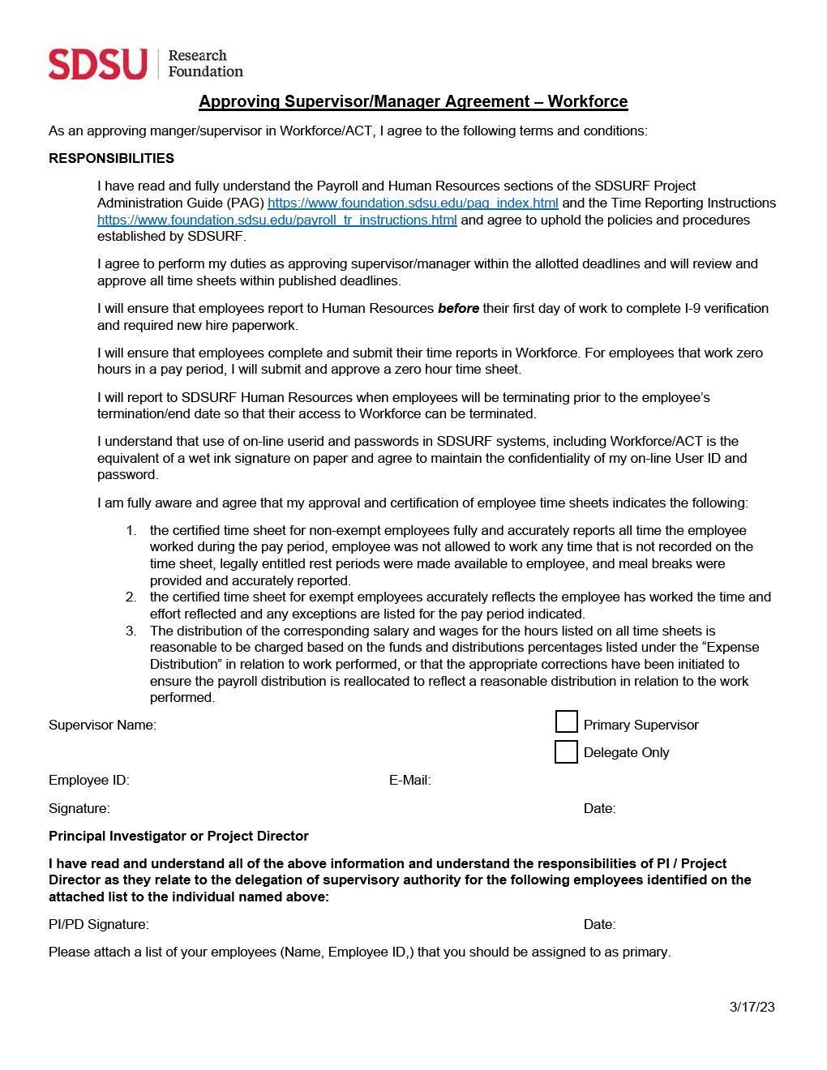
Approving Supervisor Agreement - Workforce

